Slide 1
Zero to wifi
ESP8266 & THE $2.50 PATH TO WIFI ENABLED DEVICES

Slide 2

Who I am
@technolomaniac
github: sfgit
hackaday.io/matt
Email:
technolomaniac@gmail.com
mb@supplyframe.com
matt@hackaday.com
Notes:
So what’s next? There is a renaissance in hardware happening right now. Some people are calling it the hardware revolution. This revolution is really a convergence of several major trends happening in the space. And the end result is that it’s becoming easier and more economically viable for people to build things with hardware.
The hacker/maker movement has made hardware cool again. Hacklabs and makerspaces are springing up all over the world.
Arduino, raspberry pi, AVR, beaglebone have all emerged as easy entry point development platforms for people that aren’t EE’s but know how to code
3D printers and scanners have become a mass market product that allows people to imagine something and have a physical model within hours
Crowdfunding lets people guage market demand at the concept phase.
Specialized ems companies have sprung up all over the place that do quick turn prototyping. So now people can iterate on hardware products similarly to how they do with software
The barriers have come down for an individual or small company to get access to cheap, reliable volume production in China
IOT is driving a ton of new product ideas that are all hardware dependent. And analysts are predicting that it will be a massive market
Many of the major semi companies are jumping on the bandwagon. both Intel and TI announced major development efforts with Arduino. 2 years ago folks would have said that’s impossible.
More capital is coming into the space through incubators, accelerators and VCs will follow
From where I sit this all ads up to a big opportunity for supplyframe. There seem to be major parallels to how opens source drove a major wave in software.

Slide 3

How I self-identify?
Electrical Engineer / PCB Designer
Embedded SW Enthusiast
Radio / Wireless Fan Boy
Product Architect
Teacher / Author / Mentor
Advocate for Social Change Thru Technology
…I build stuff
Notes:
So what’s next? There is a renaissance in hardware happening right now. Some people are calling it the hardware revolution. This revolution is really a convergence of several major trends happening in the space. And the end result is that it’s becoming easier and more economically viable for people to build things with hardware.
The hacker/maker movement has made hardware cool again. Hacklabs and makerspaces are springing up all over the world.
Arduino, raspberry pi, AVR, beaglebone have all emerged as easy entry point development platforms for people that aren’t EE’s but know how to code
3D printers and scanners have become a mass market product that allows people to imagine something and have a physical model within hours
Crowdfunding lets people guage market demand at the concept phase.
Specialized ems companies have sprung up all over the place that do quick turn prototyping. So now people can iterate on hardware products similarly to how they do with software
The barriers have come down for an individual or small company to get access to cheap, reliable volume production in China
IOT is driving a ton of new product ideas that are all hardware dependent. And analysts are predicting that it will be a massive market
Many of the major semi companies are jumping on the bandwagon. both Intel and TI announced major development efforts with Arduino. 2 years ago folks would have said that’s impossible.
More capital is coming into the space through incubators, accelerators and VCs will follow
From where I sit this all ads up to a big opportunity for supplyframe. There seem to be major parallels to how opens source drove a major wave in software.

Slide 4

What I build…
Radios / RF Transceivers
Sensors & Control Stuff
Connected Hardware, Software, & Services
Industrial Control Equipment
Electronics Design Software
AI / Machine Intelligences for Connected Devices
Modular Electronics / Development Hardware
Products of various sorts
Notes:
So what’s next? There is a renaissance in hardware happening right now. Some people are calling it the hardware revolution. This revolution is really a convergence of several major trends happening in the space. And the end result is that it’s becoming easier and more economically viable for people to build things with hardware.
The hacker/maker movement has made hardware cool again. Hacklabs and makerspaces are springing up all over the world.
Arduino, raspberry pi, AVR, beaglebone have all emerged as easy entry point development platforms for people that aren’t EE’s but know how to code
3D printers and scanners have become a mass market product that allows people to imagine something and have a physical model within hours
Crowdfunding lets people guage market demand at the concept phase.
Specialized ems companies have sprung up all over the place that do quick turn prototyping. So now people can iterate on hardware products similarly to how they do with software
The barriers have come down for an individual or small company to get access to cheap, reliable volume production in China
IOT is driving a ton of new product ideas that are all hardware dependent. And analysts are predicting that it will be a massive market
Many of the major semi companies are jumping on the bandwagon. both Intel and TI announced major development efforts with Arduino. 2 years ago folks would have said that’s impossible.
More capital is coming into the space through incubators, accelerators and VCs will follow
From where I sit this all ads up to a big opportunity for supplyframe. There seem to be major parallels to how opens source drove a major wave in software.

Slide 5
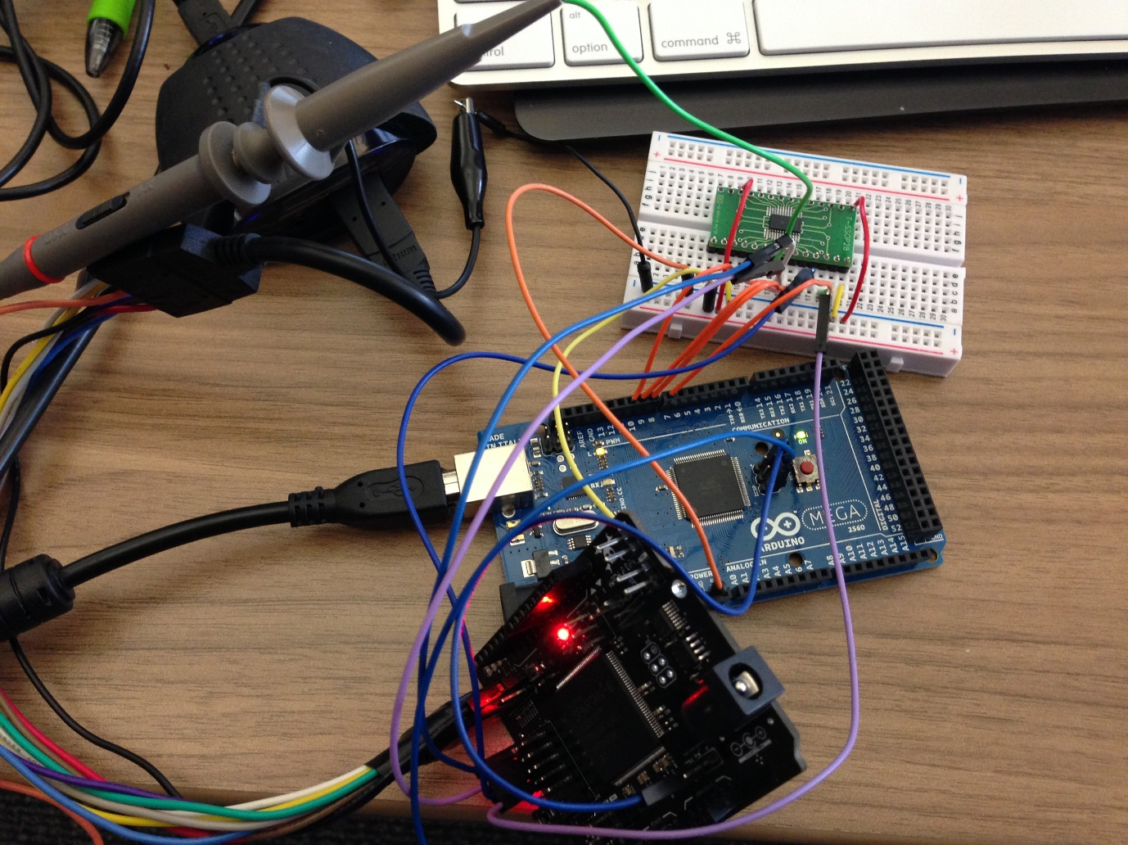

Where it all begins… (it’s ok, we all do this)
Figure 1. Modeling ideas with breadboard, prototype board and development kits
Notes:
So what’s next? There is a renaissance in hardware happening right now. Some people are calling it the hardware revolution. This revolution is really a convergence of several major trends happening in the space. And the end result is that it’s becoming easier and more economically viable for people to build things with hardware.
The hacker/maker movement has made hardware cool again. Hacklabs and makerspaces are springing up all over the world.
Arduino, raspberry pi, AVR, beaglebone have all emerged as easy entry point development platforms for people that aren’t EE’s but know how to code
3D printers and scanners have become a mass market product that allows people to imagine something and have a physical model within hours
Crowdfunding lets people guage market demand at the concept phase.
Specialized ems companies have sprung up all over the place that do quick turn prototyping. So now people can iterate on hardware products similarly to how they do with software
The barriers have come down for an individual or small company to get access to cheap, reliable volume production in China
IOT is driving a ton of new product ideas that are all hardware dependent. And analysts are predicting that it will be a massive market
Many of the major semi companies are jumping on the bandwagon. both Intel and TI announced major development efforts with Arduino. 2 years ago folks would have said that’s impossible.
More capital is coming into the space through incubators, accelerators and VCs will follow
From where I sit this all ads up to a big opportunity for supplyframe. There seem to be major parallels to how opens source drove a major wave in software.

Slide 6

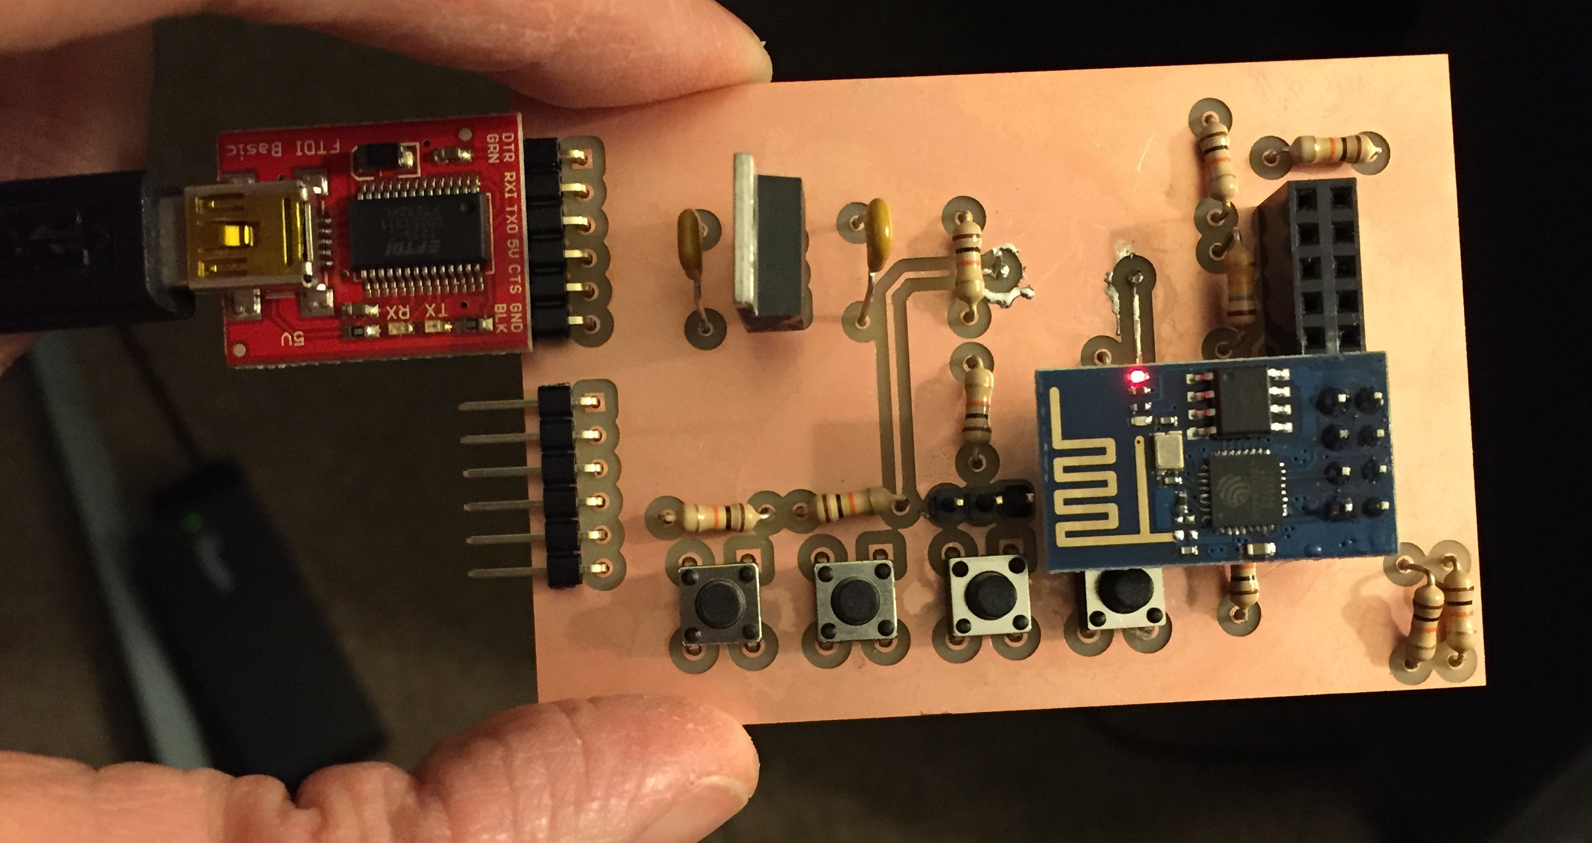
Our First “Real” Design ESP8266-01 WIFI MCU, Nodejs, & AT
Notes:
So what’s next? There is a renaissance in hardware happening right now. Some people are calling it the hardware revolution. This revolution is really a convergence of several major trends happening in the space. And the end result is that it’s becoming easier and more economically viable for people to build things with hardware.
The hacker/maker movement has made hardware cool again. Hacklabs and makerspaces are springing up all over the world.
Arduino, raspberry pi, AVR, beaglebone have all emerged as easy entry point development platforms for people that aren’t EE’s but know how to code
3D printers and scanners have become a mass market product that allows people to imagine something and have a physical model within hours
Crowdfunding lets people guage market demand at the concept phase.
Specialized ems companies have sprung up all over the place that do quick turn prototyping. So now people can iterate on hardware products similarly to how they do with software
The barriers have come down for an individual or small company to get access to cheap, reliable volume production in China
IOT is driving a ton of new product ideas that are all hardware dependent. And analysts are predicting that it will be a massive market
Many of the major semi companies are jumping on the bandwagon. both Intel and TI announced major development efforts with Arduino. 2 years ago folks would have said that’s impossible.
More capital is coming into the space through incubators, accelerators and VCs will follow
From where I sit this all ads up to a big opportunity for supplyframe. There seem to be major parallels to how opens source drove a major wave in software.

Slide 7
Some ESP Basics
WIFI Module
Access Point / Server or Web Client
Numerous firmware options
Program directly via C
Use standard AT commands (a’la COM port)
Use NodeMCU + LUA
LUA Interpreter which supports NodeJS-like commands
Cost is extremely cheap (~$2-3)
A little power hungry (Peak current ~400mA @ 3V3)
Few IOs (best to break out to separate MCU)
Arduino Library Available via Adafruit

Slide 8
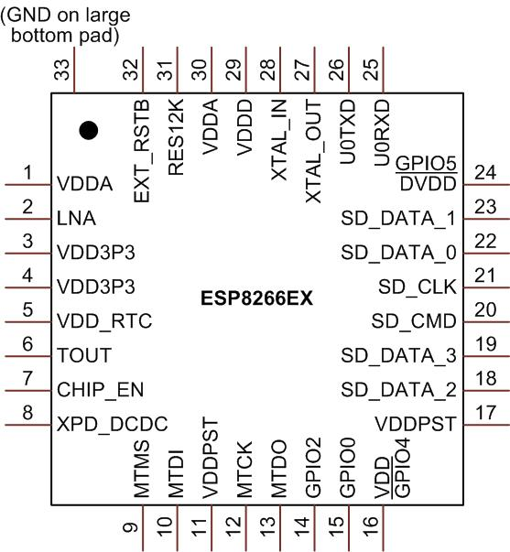
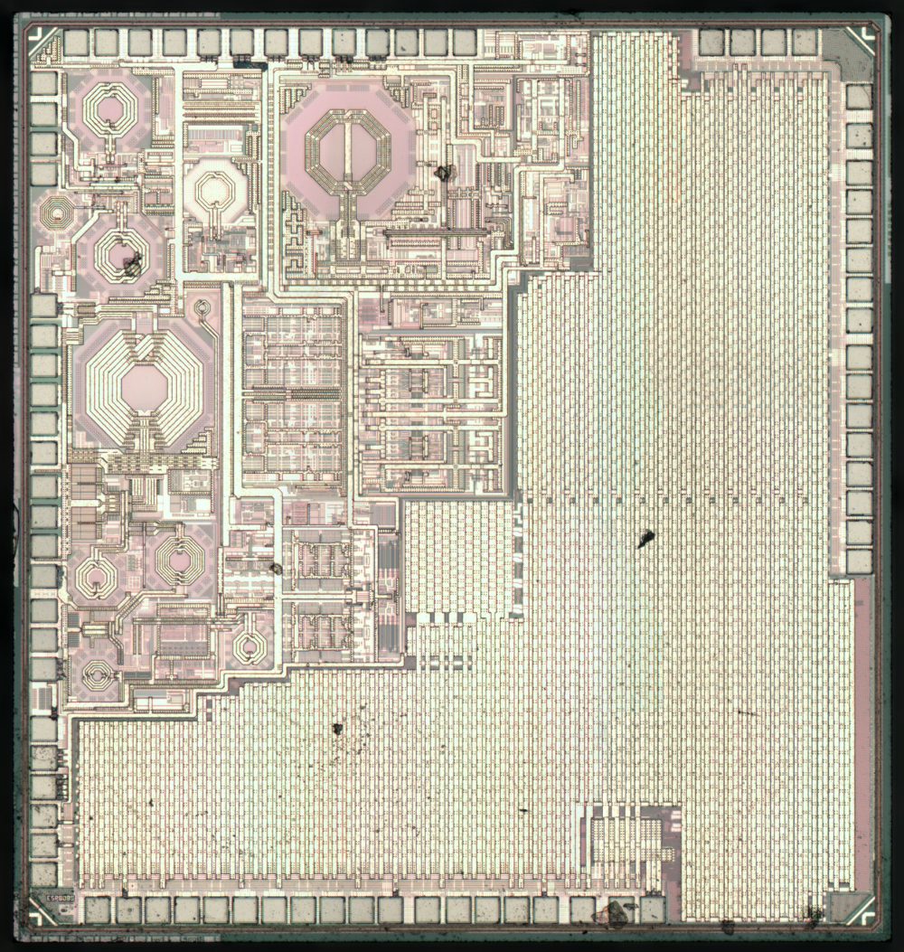
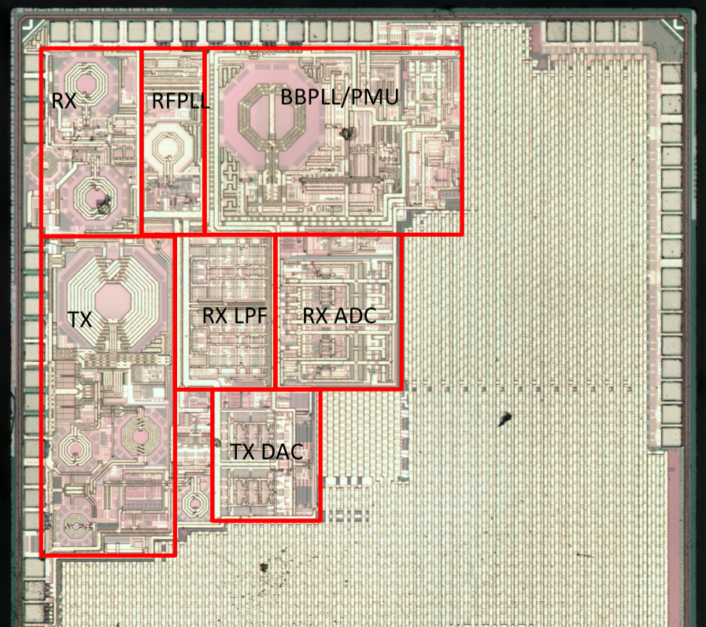
Some ESP Basics
Nerd porn…

Slide 9
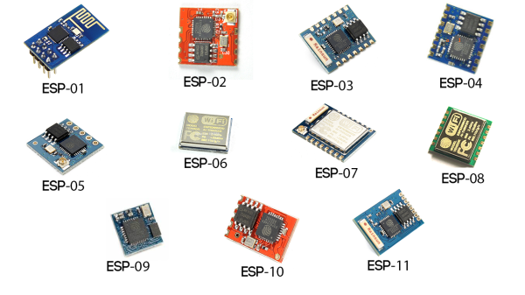
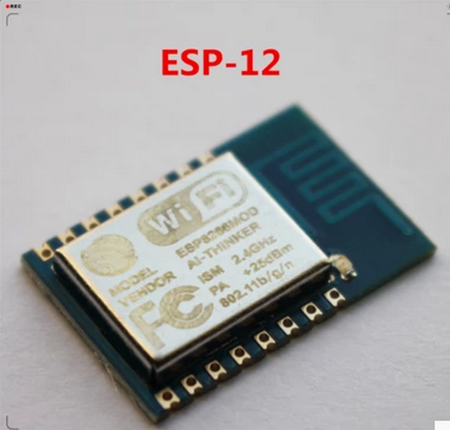
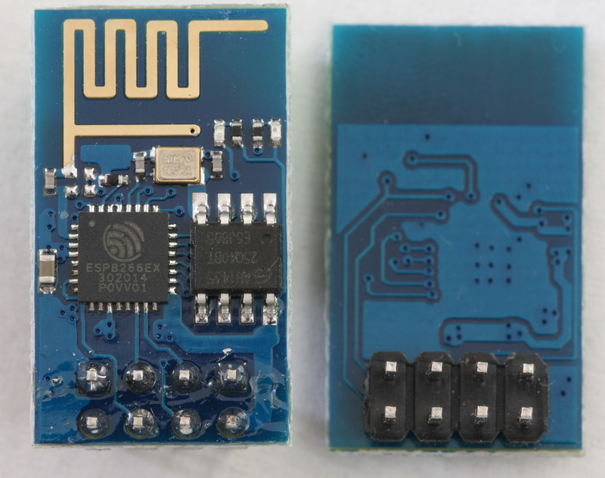
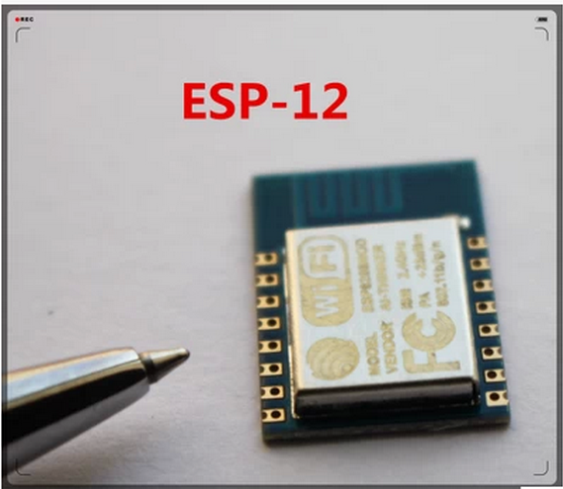
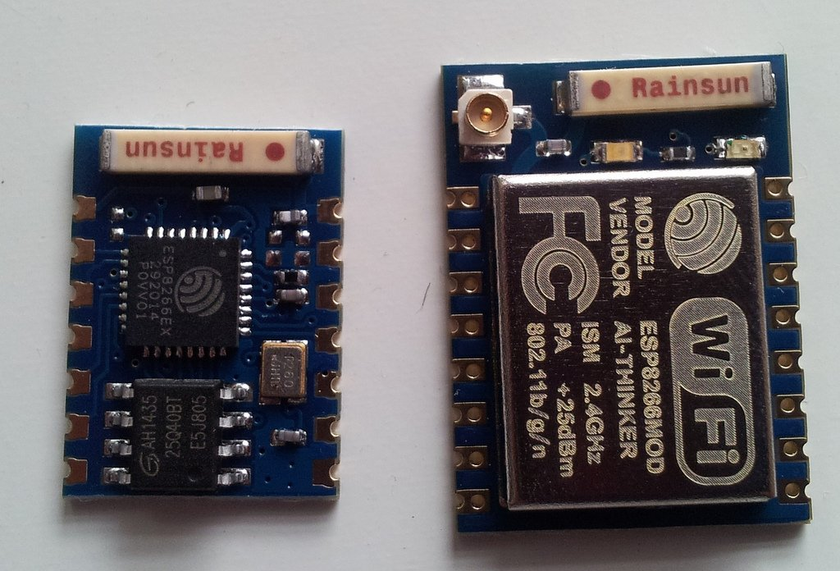
Some ESP Basics
2mm Spacing
ESP-03
ESP-07
ESP-01

Slide 10
Some ESP Basics
What is this ESP8266?
It has GPIO, I2C, ADC, SPI, PWM and some more
It's running at 80MHz
64KBytes of instruction RAM
96KBytes of data RAM
64KBytes boot ROM
It has a Winbond W25Q40BVNIG SPI flash
Size 4Mbit (512KByte)
Clock speed 104Mhz
Erase size (Bytes) 4K, 32K, 64K
Voltage 3v
It's a RISC architecture
The core is a 106micro Diamond Standard core (LX3) made by Tensilica
The ESP8266 chip is made by Espressif
Modules bearing this chip are made by various manufacturers

Slide 11
ESP Basics
Features
802.11 b/g/n protocol
Wi-Fi 2.4 GHz, support WPA/WPA2
Super small module size (11.5mm x 11.5mm)
Integrated 10-bit ADC
Integrated TCP/IP protocol stack (ipv4 only at the moment)
Integrated TR switch, BALUN, LNA, power amplifier and matching network
Integrated PLL, regulators, and power management units
+20dBm output power in 802.11b mode
Supports antenna diversity
Deep sleep power <10uA, Power down leakage current < 5uA
Integrated low power 32-bit MCU
SDIO 2.0, SPI, UART, I2C
STBC, 1x1 MIMO, 2x1 MIMO
A-MPDU & A-MSDU aggregation & 0.4μs guard interval (used for Frame Aggr)
Wake up and transmit packets in < 2ms
Standby power consumption of < 1.0mW (DTIM3)
Operating temperature range -40C ~ 125C

Slide 12
Some ESP Basics
Pin | Name | Type | GPIO | Function | Conditions for use
1 | VDDA | P |  | Analog Power | 3.0 ~3.6V
2 | LNA | I/O |  | RF Antenna Interface,Chip Output Impedance=50 Ω | No matching required but we recommend that
 |  |  |  |  | the π- type matching network is retained.
3 | VDD3P3 | P |  | Amplifier Power 3.0~3.6V
4 | VDD3P3 | P |  | Amplifier Power 3.0~3.6V
5 | VDD_RTC | P |  | NC(1.1V)
6 | TOUT | I |  | ADC Pin
7 | CHIP_EN | I |  | Chip Enable. | High: On, chip works properly; Low: Off, small current
8 | XPD_DCDC | I/O | GPIO16 | Deep-Sleep Wakeup
9 | MTMS | I/O | GPIO14 | HSPICLK
10 | MTDI | I/O | GPIO12 | HSPIQ
11 | VDDPST | P |  | Digital/IO | Power Supply (1.8V~3.3V)
12 | MTCK | I/O | GPIO13 | HSPID
13 | MTDO | I/O | GPIO15 | HSPICS
14 | GPIO2 | I/O | GPIO2 | UART Tx during flash progamming
15 | GPIO0 | I/O | GPIO0 | SPICS2
16 | GPIO4 | I/O | GPIO4

Slide 13
Some ESP Basics
Pin | Name | Type | GPIO | Function | Conditions for use
17 | VDDPST | P |  | Digital/IO | Power Supply (1.8V~3.3V)
18 | SDIO_DATA_2 | I/O |  | Connect to SD_D2 (Series R 200Ω);SPIHD; HSPIHD
19 | SDIO_DATA_3 | I/O |  | Connect to SD_D3 (Series R 200Ω); SPIWP; HSPIWP
20 | SDIO_CMD | I/O |  | Connect to SD_CMD(Series R 200Ω); SPICS0
21 | SDIO_CLK | I/O |  | Connect to SD_CLK (Series R 200Ω); SPICLK
22 | SDIO_DATA_0 | I/O |  | Connect to SD_D0 (Series R 200Ω); SPIQ
23 | SDIO_DATA_1 | I/O |  | Connect to SD_D1 (Series R 200Ω); SPID
24 | GPIO5 | I/O | GPIO5
25 | U0RXD | I/O | GPIO3 | UART Rx during flash progamming
26 | U0TXD | I/O | GPIO1 | UART Tx during flash progamming; SPICS1
27 | XTAL_OUT | I/O |  | Connect to crystal output, can be used to provide BT clock input
28 | XTAL_IN | I/O |  | Connect to crystal input
29 | VDDD | P |  | Analog Power 3.0~3.6V
30 | VDDA | P |  | Analog Power 3.0~3.6V
31 | RES12K | I |  | Connect to series R 12kΩ to ground
32 | EXT_RSTB | I |  | External reset signal (Low: Active)

Slide 14
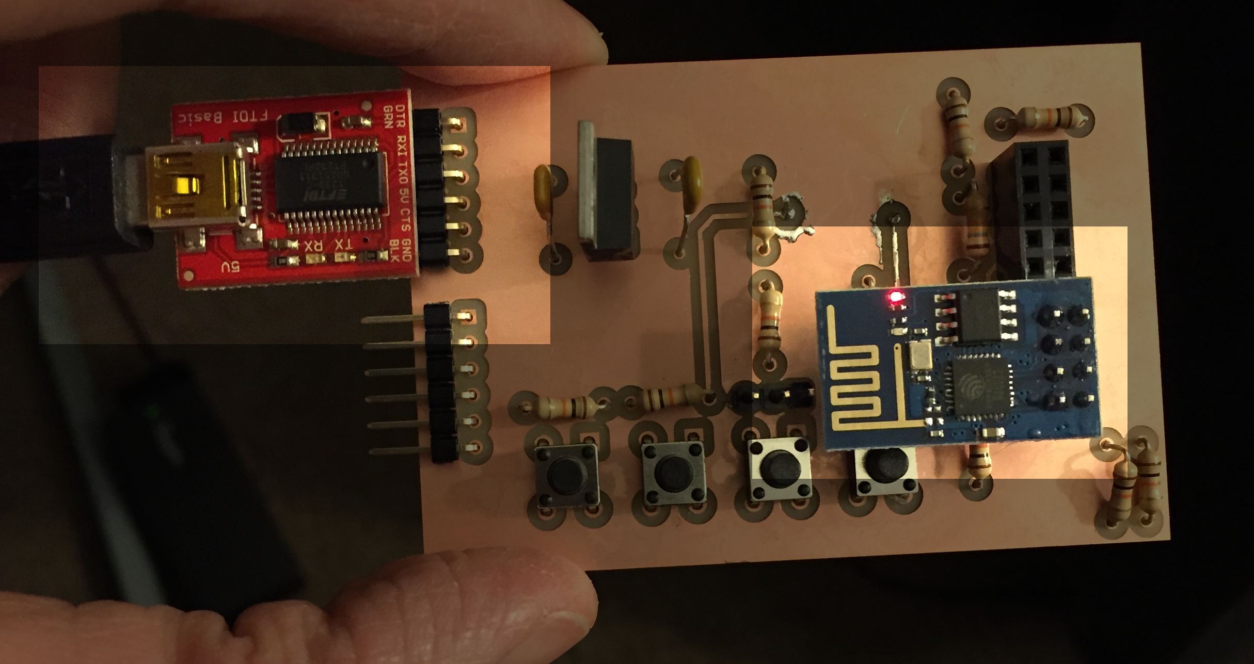
Getting Started
Get an ESP8266 module / PCB (-01 version includes PTH pins easy-ish for a breadboard)
Buy / borrow a USB-Serial converter (FTDI, Cypress, etc…Arduino can also work*)
Sparkfun, Adafruit, Amazon etc. all sell them
Determine what *other* components you need
Breadboard the connections
Measure twice, cut once
Flash the MCU with desired firmware
NodeMCU, AT Commands, SDK
Connect to other MCUs, PC, etc. and
Configure the MCU to do some “thing”

Slide 15
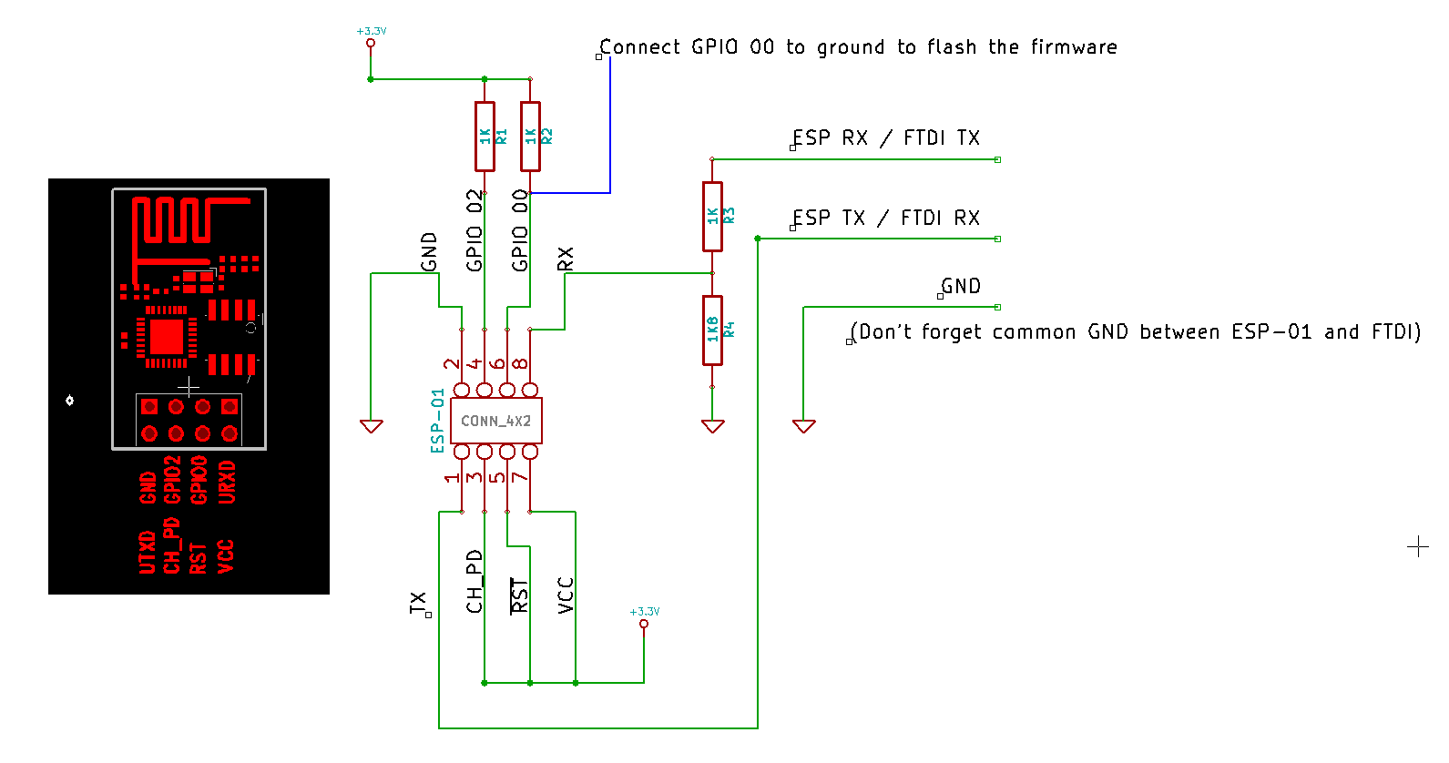
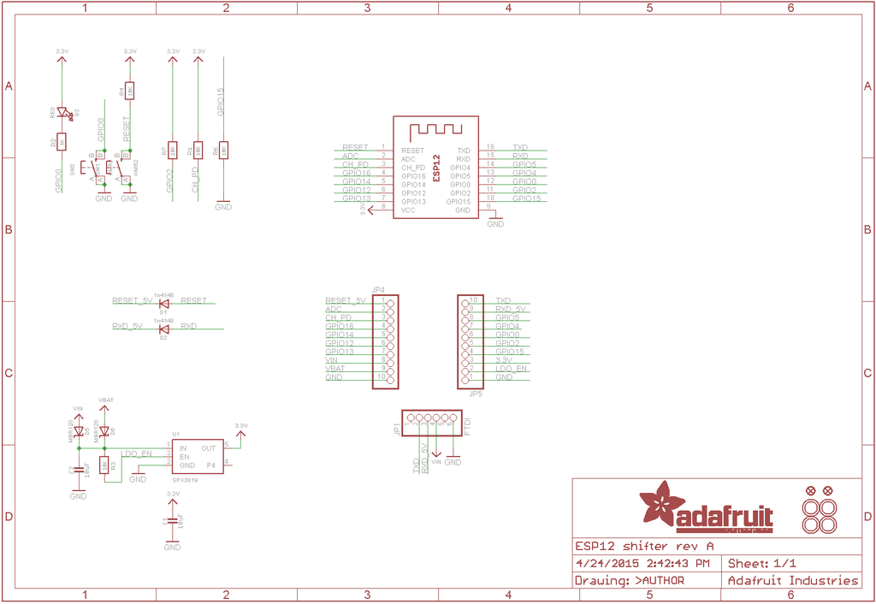
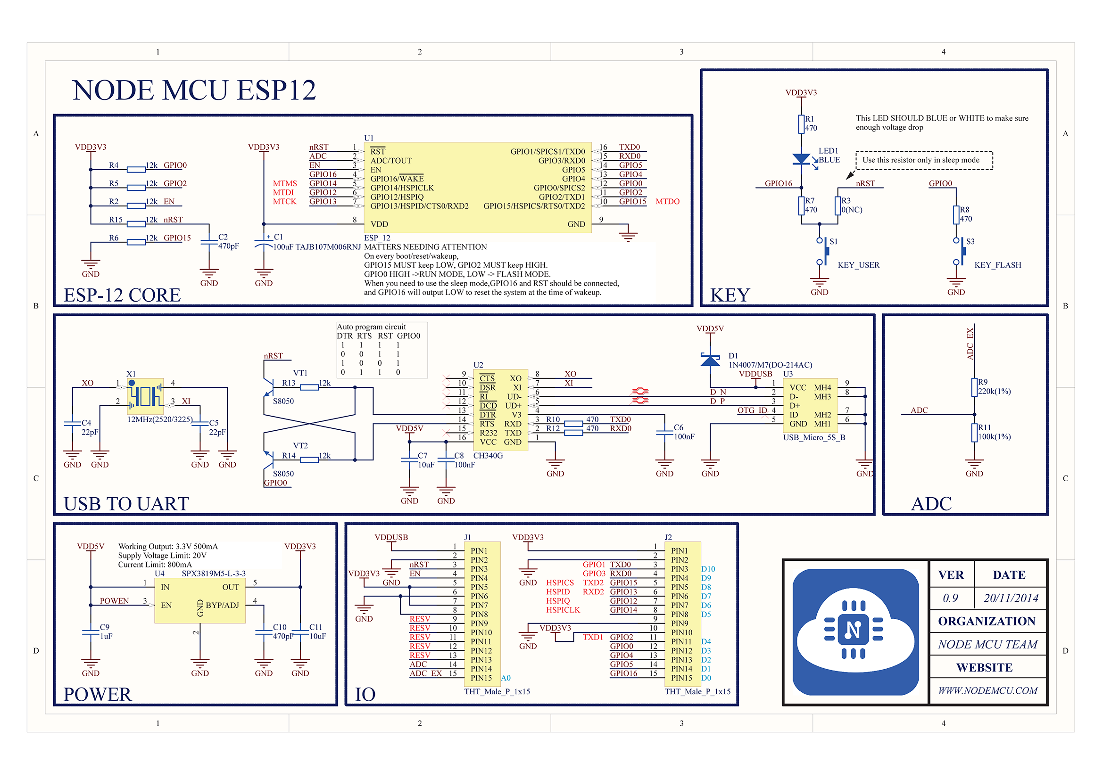
Notes:
So what’s next? There is a renaissance in hardware happening right now. Some people are calling it the hardware revolution. This revolution is really a convergence of several major trends happening in the space. And the end result is that it’s becoming easier and more economically viable for people to build things with hardware.
The hacker/maker movement has made hardware cool again. Hacklabs and makerspaces are springing up all over the world.
Arduino, raspberry pi, AVR, beaglebone have all emerged as easy entry point development platforms for people that aren’t EE’s but know how to code
3D printers and scanners have become a mass market product that allows people to imagine something and have a physical model within hours
Crowdfunding lets people guage market demand at the concept phase.
Specialized ems companies have sprung up all over the place that do quick turn prototyping. So now people can iterate on hardware products similarly to how they do with software
The barriers have come down for an individual or small company to get access to cheap, reliable volume production in China
IOT is driving a ton of new product ideas that are all hardware dependent. And analysts are predicting that it will be a massive market
Many of the major semi companies are jumping on the bandwagon. both Intel and TI announced major development efforts with Arduino. 2 years ago folks would have said that’s impossible.
More capital is coming into the space through incubators, accelerators and VCs will follow
From where I sit this all ads up to a big opportunity for supplyframe. There seem to be major parallels to how opens source drove a major wave in software.

Slide 16
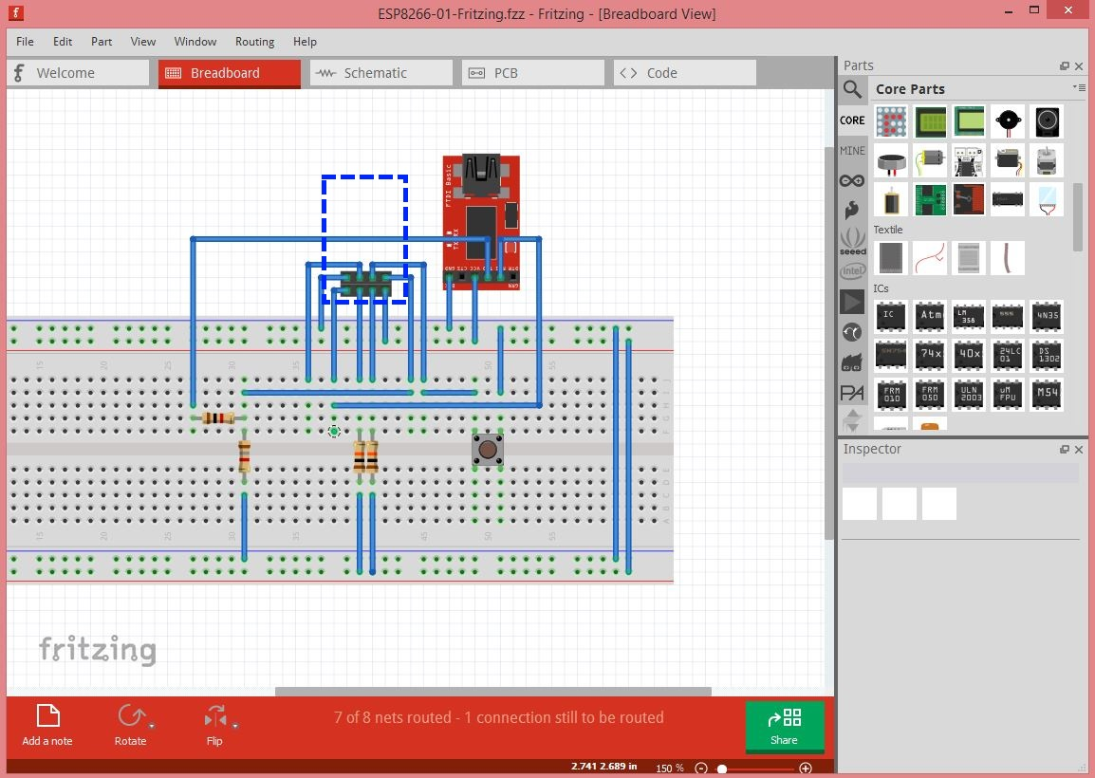

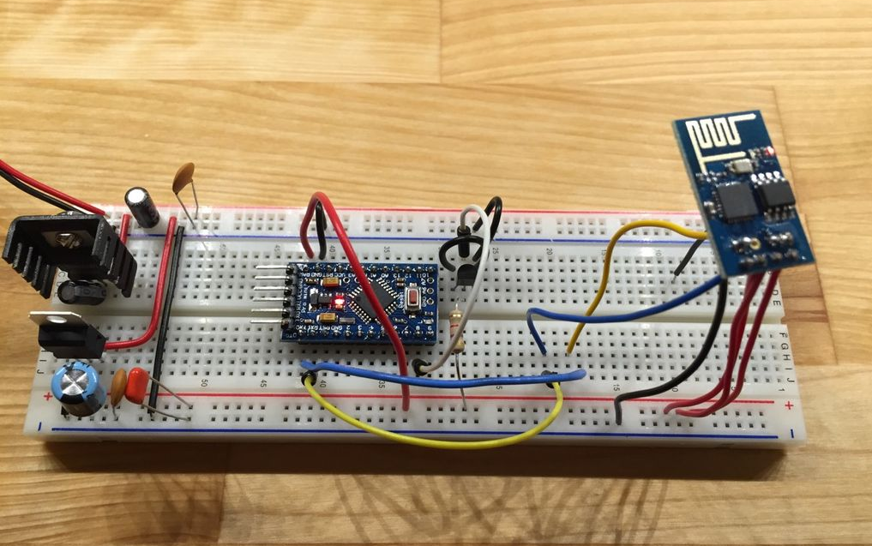
Breadboarding Fritzing is your friend (remember, measure twice…cut once)

Slide 17
Software Tools for the ESP
NodeMCU-Flasher (Github)
NodeMCU / AT Firmware (both Github)
ESPlorer (checkout ESPlorer.ru)
(Optional) Terminal Program (PuTTY, Terminal v1.93b*, MAC Terminal, others)
(Optional) Arduino or other CPU with UART
Your Program
Firmware

Slide 18
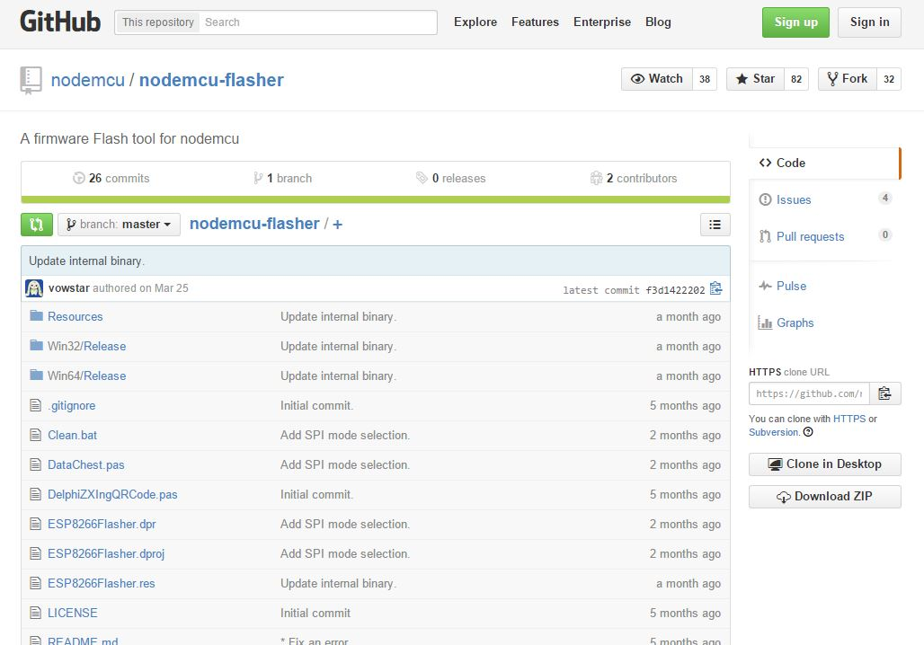
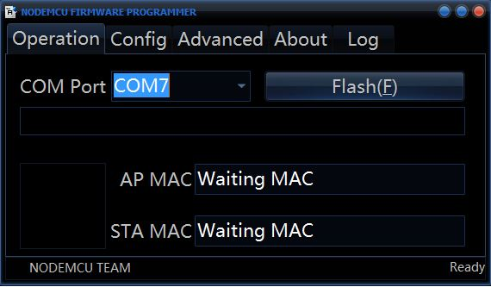
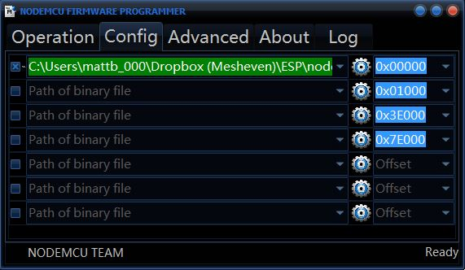
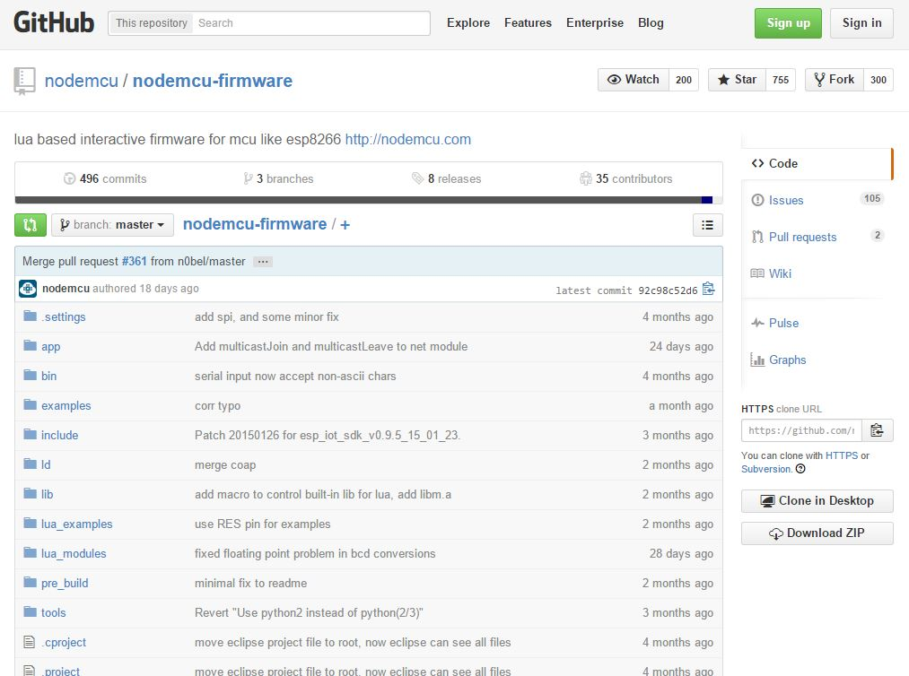
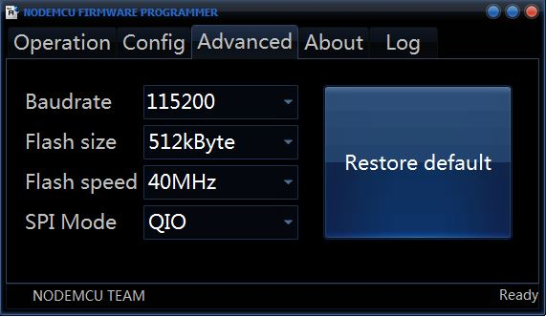
PROGRAMMING THE ESP FIRMWARE
“Flashing” the ESP8266 firmware over serial port (UART)

Slide 19
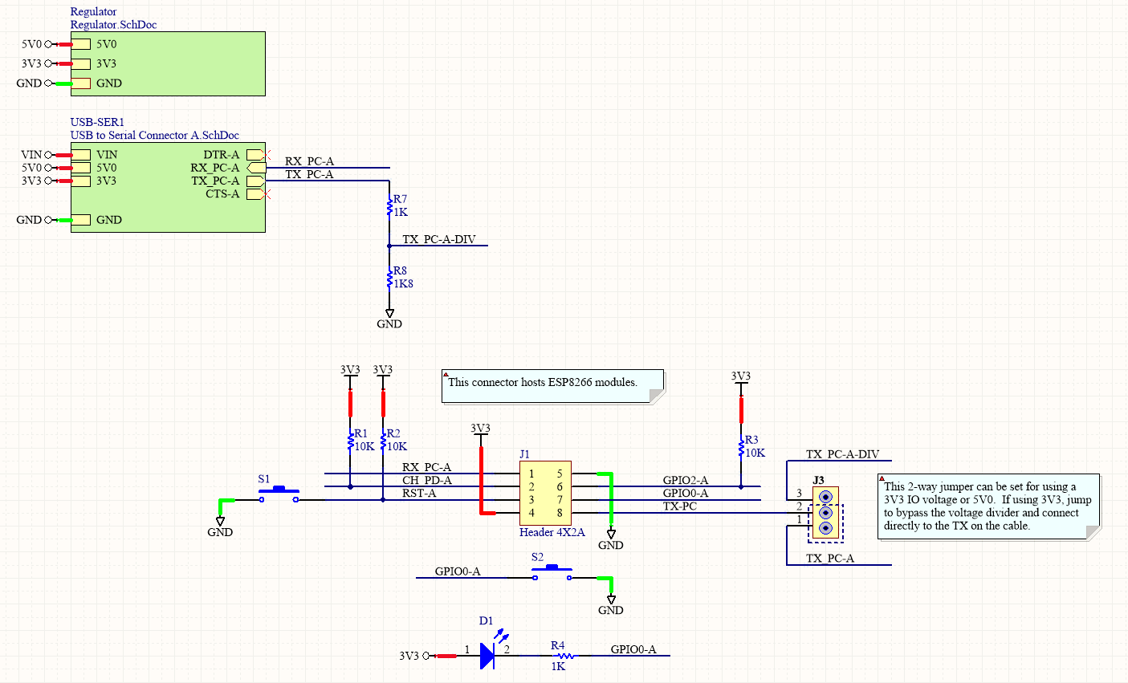
PROGRAMMING THE ESP FIRMWARE
“Flashing” the ESP8266 firmware over serial port (UART)
Pull GPIO0 Low
RESET the device (active low)
Begin programming

Slide 20
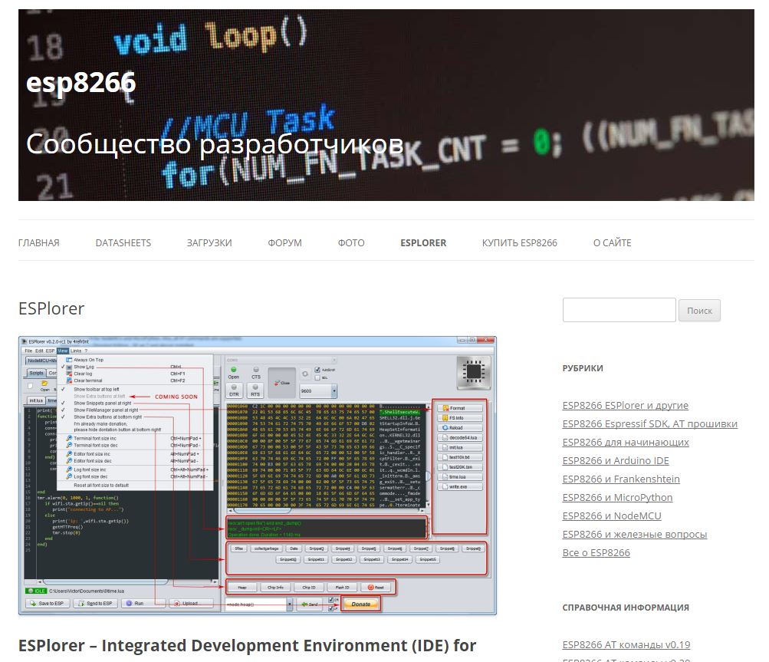
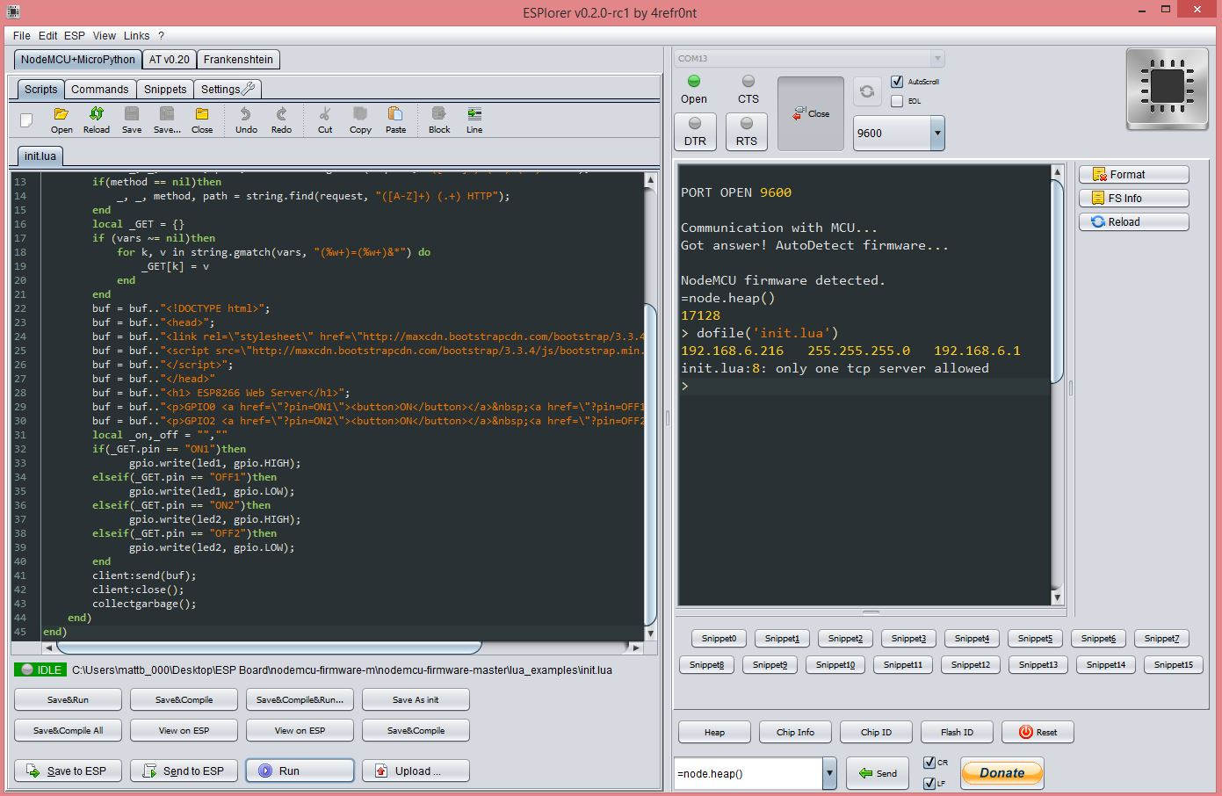
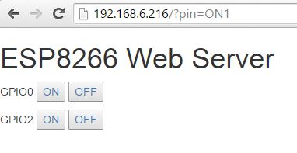
Running Your Own Programs
Programming the ESP8266 to do some thing

Slide 21
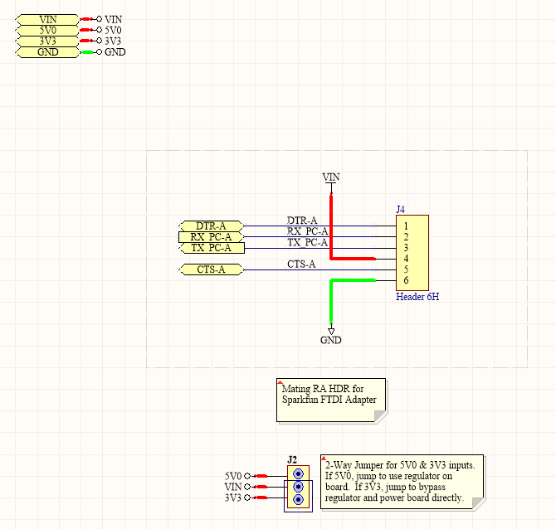
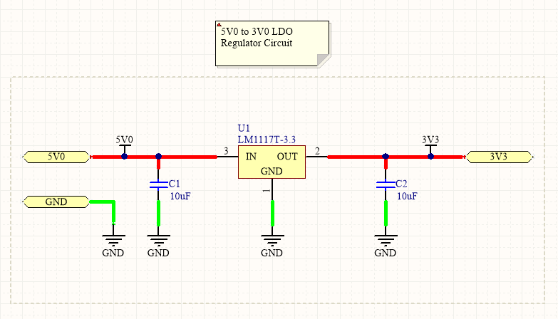
DEVICE IN QUESTION
Building Something Useful

Slide 22
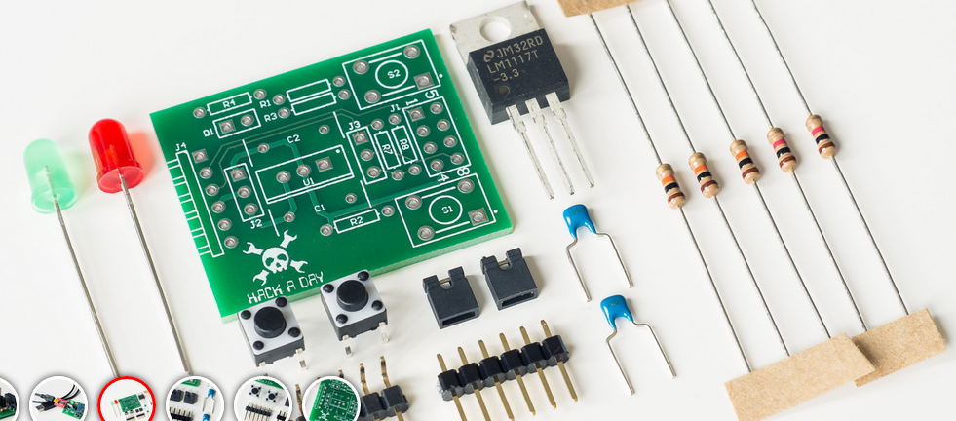
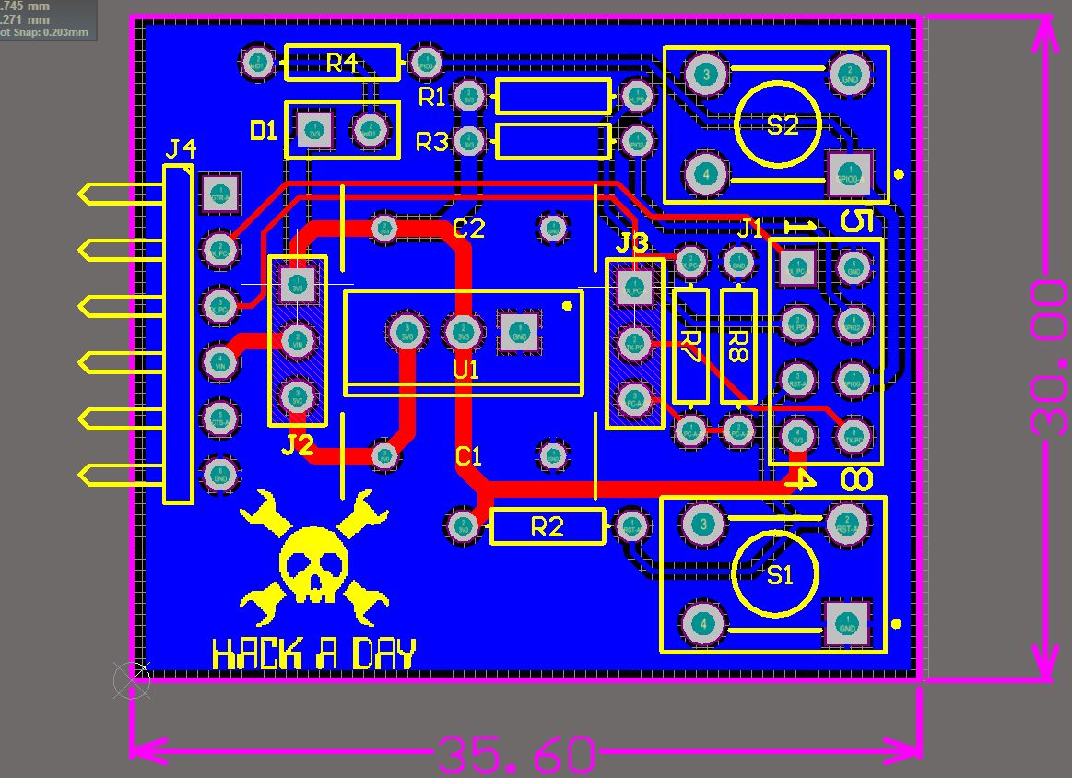
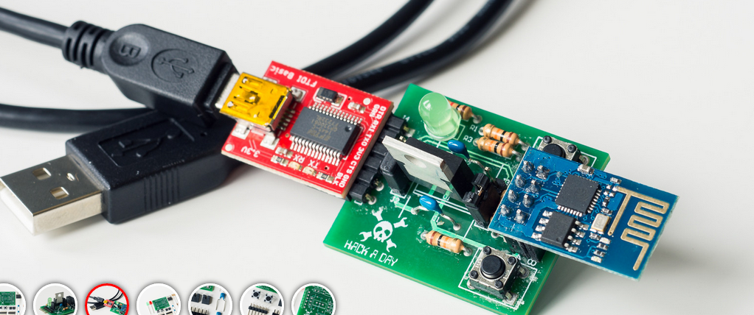
DEVICE IN QUESTION
Building Something Useful

Slide 23
Running Your Own Programs
Programming the ESP8266 to do some thing

Slide 24
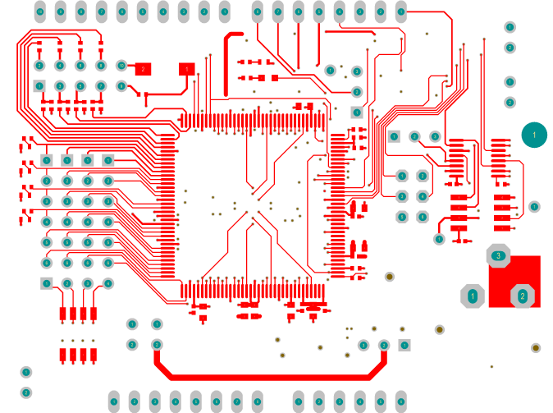
Building a PCB 101 Ok…Maybe 201

Slide 25
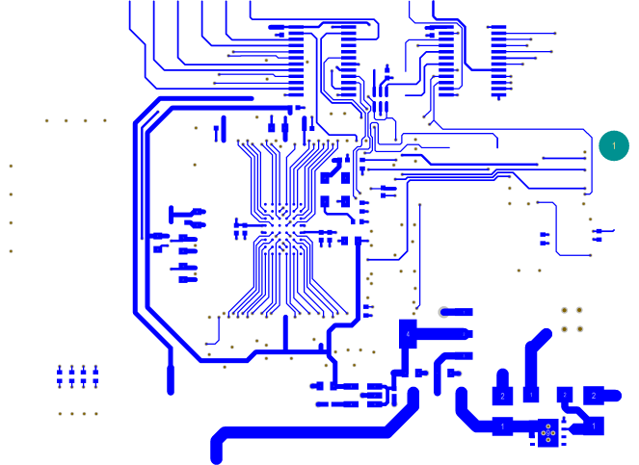
Level Set - What is a PCB?
Just another means to connect components in meaningful ways

Slide 26
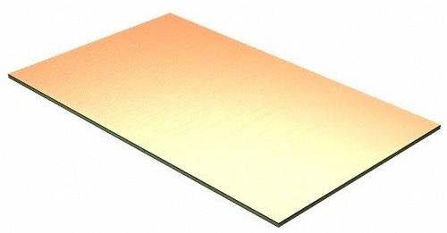
Pre-clad Copper Circuit Board Panel
Figure 2. Unused preclad copper circuit board material
Notes:
So what’s next? There is a renaissance in hardware happening right now. Some people are calling it the hardware revolution. This revolution is really a convergence of several major trends happening in the space. And the end result is that it’s becoming easier and more economically viable for people to build things with hardware.
The hacker/maker movement has made hardware cool again. Hacklabs and makerspaces are springing up all over the world.
Arduino, raspberry pi, AVR, beaglebone have all emerged as easy entry point development platforms for people that aren’t EE’s but know how to code
3D printers and scanners have become a mass market product that allows people to imagine something and have a physical model within hours
Crowdfunding lets people guage market demand at the concept phase.
Specialized ems companies have sprung up all over the place that do quick turn prototyping. So now people can iterate on hardware products similarly to how they do with software
The barriers have come down for an individual or small company to get access to cheap, reliable volume production in China
IOT is driving a ton of new product ideas that are all hardware dependent. And analysts are predicting that it will be a massive market
Many of the major semi companies are jumping on the bandwagon. both Intel and TI announced major development efforts with Arduino. 2 years ago folks would have said that’s impossible.
More capital is coming into the space through incubators, accelerators and VCs will follow
From where I sit this all ads up to a big opportunity for supplyframe. There seem to be major parallels to how opens source drove a major wave in software.

Slide 27
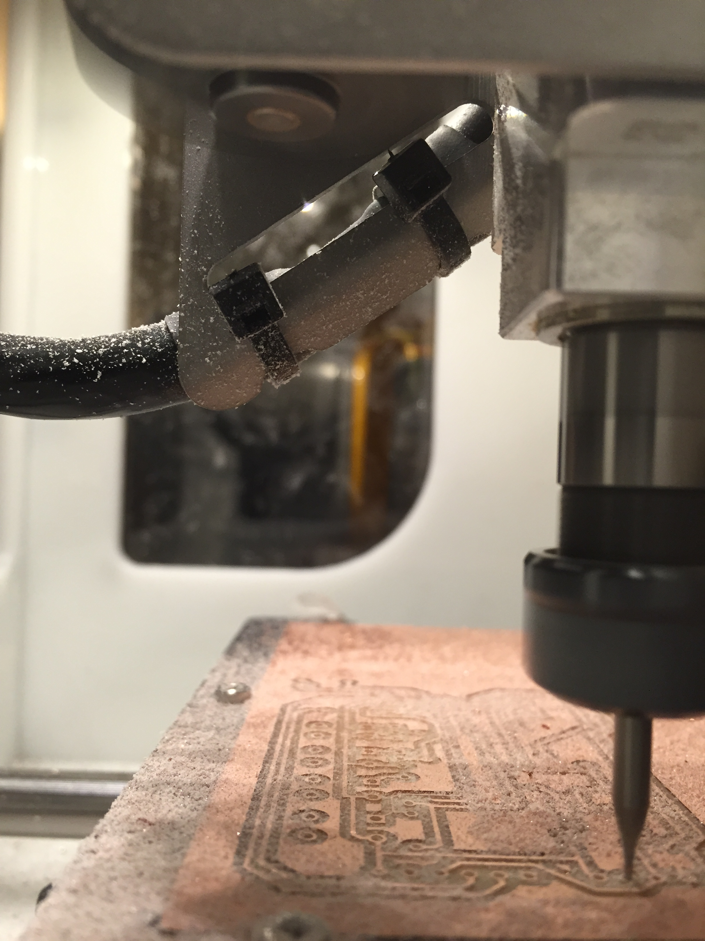
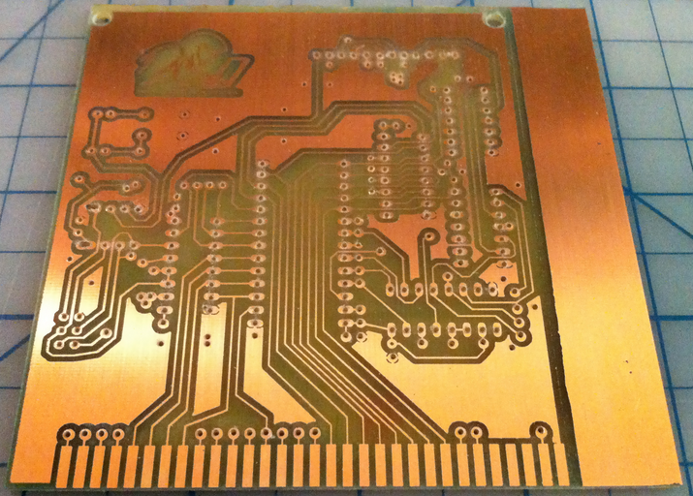
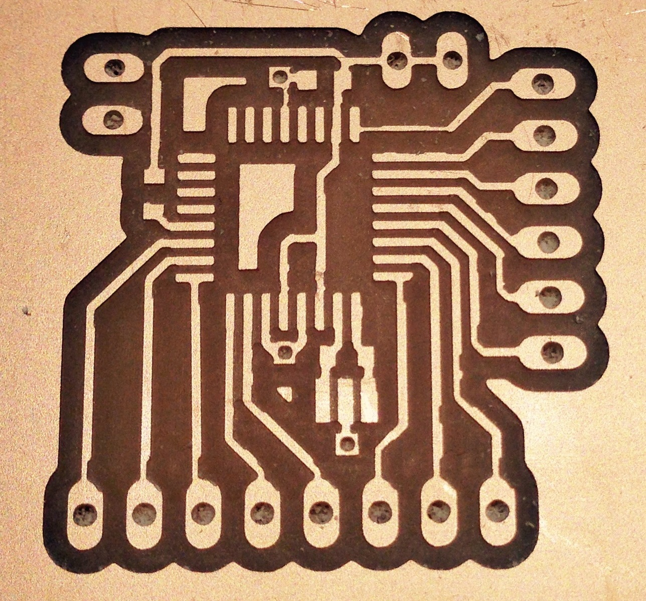
Routed Boards
No Components, No Mask (i.e. the green stuff)
Figure 3. Circuit routed from preclad PCB material
Notes:
So what’s next? There is a renaissance in hardware happening right now. Some people are calling it the hardware revolution. This revolution is really a convergence of several major trends happening in the space. And the end result is that it’s becoming easier and more economically viable for people to build things with hardware.
The hacker/maker movement has made hardware cool again. Hacklabs and makerspaces are springing up all over the world.
Arduino, raspberry pi, AVR, beaglebone have all emerged as easy entry point development platforms for people that aren’t EE’s but know how to code
3D printers and scanners have become a mass market product that allows people to imagine something and have a physical model within hours
Crowdfunding lets people guage market demand at the concept phase.
Specialized ems companies have sprung up all over the place that do quick turn prototyping. So now people can iterate on hardware products similarly to how they do with software
The barriers have come down for an individual or small company to get access to cheap, reliable volume production in China
IOT is driving a ton of new product ideas that are all hardware dependent. And analysts are predicting that it will be a massive market
Many of the major semi companies are jumping on the bandwagon. both Intel and TI announced major development efforts with Arduino. 2 years ago folks would have said that’s impossible.
More capital is coming into the space through incubators, accelerators and VCs will follow
From where I sit this all ads up to a big opportunity for supplyframe. There seem to be major parallels to how opens source drove a major wave in software.

Slide 28

Basic PCB Terminology

Slide 29
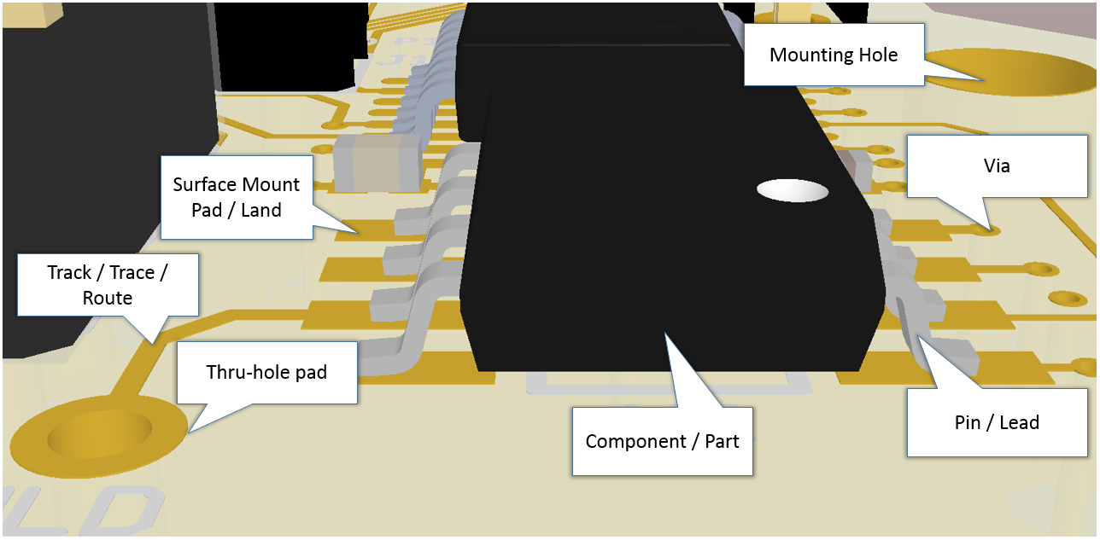
`
Some basic PCB terminology
Figure 4. Some standard PCB objects
Notes:
So what’s next? There is a renaissance in hardware happening right now. Some people are calling it the hardware revolution. This revolution is really a convergence of several major trends happening in the space. And the end result is that it’s becoming easier and more economically viable for people to build things with hardware.
The hacker/maker movement has made hardware cool again. Hacklabs and makerspaces are springing up all over the world.
Arduino, raspberry pi, AVR, beaglebone have all emerged as easy entry point development platforms for people that aren’t EE’s but know how to code
3D printers and scanners have become a mass market product that allows people to imagine something and have a physical model within hours
Crowdfunding lets people guage market demand at the concept phase.
Specialized ems companies have sprung up all over the place that do quick turn prototyping. So now people can iterate on hardware products similarly to how they do with software
The barriers have come down for an individual or small company to get access to cheap, reliable volume production in China
IOT is driving a ton of new product ideas that are all hardware dependent. And analysts are predicting that it will be a massive market
Many of the major semi companies are jumping on the bandwagon. both Intel and TI announced major development efforts with Arduino. 2 years ago folks would have said that’s impossible.
More capital is coming into the space through incubators, accelerators and VCs will follow
From where I sit this all ads up to a big opportunity for supplyframe. There seem to be major parallels to how opens source drove a major wave in software.

Slide 30
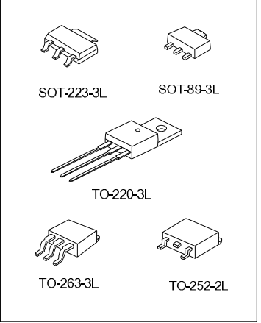
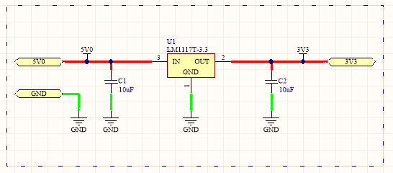
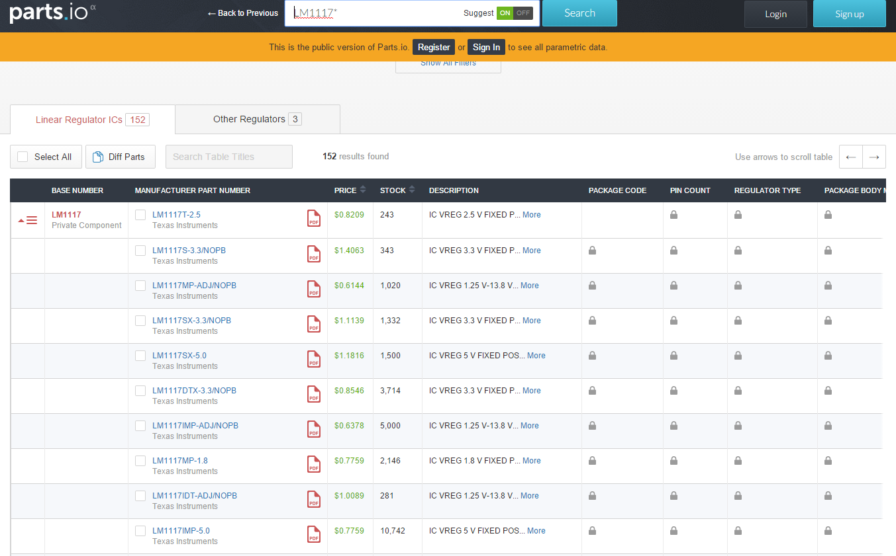
Components / Parts

Slide 31
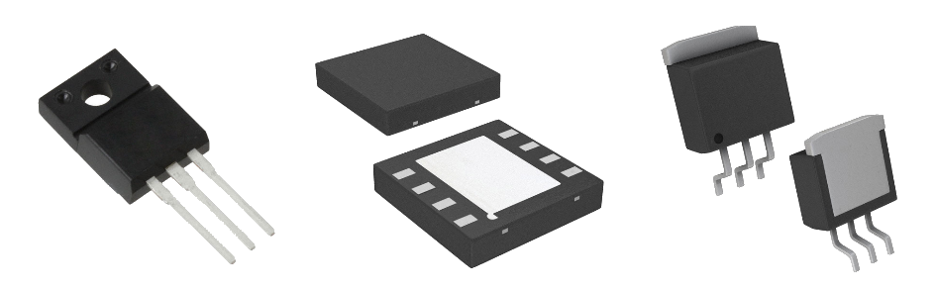
Various Types of Component Packages
Notes:
So what’s next? There is a renaissance in hardware happening right now. Some people are calling it the hardware revolution. This revolution is really a convergence of several major trends happening in the space. And the end result is that it’s becoming easier and more economically viable for people to build things with hardware.
The hacker/maker movement has made hardware cool again. Hacklabs and makerspaces are springing up all over the world.
Arduino, raspberry pi, AVR, beaglebone have all emerged as easy entry point development platforms for people that aren’t EE’s but know how to code
3D printers and scanners have become a mass market product that allows people to imagine something and have a physical model within hours
Crowdfunding lets people guage market demand at the concept phase.
Specialized ems companies have sprung up all over the place that do quick turn prototyping. So now people can iterate on hardware products similarly to how they do with software
The barriers have come down for an individual or small company to get access to cheap, reliable volume production in China
IOT is driving a ton of new product ideas that are all hardware dependent. And analysts are predicting that it will be a massive market
Many of the major semi companies are jumping on the bandwagon. both Intel and TI announced major development efforts with Arduino. 2 years ago folks would have said that’s impossible.
More capital is coming into the space through incubators, accelerators and VCs will follow
From where I sit this all ads up to a big opportunity for supplyframe. There seem to be major parallels to how opens source drove a major wave in software.

Slide 32
Lands, Pads, Leads, Pins (?)
PTH – Plated Thru Hole
TH – Thru Hole
SMT / SMD – Surface Mount Technology / Device

Slide 33
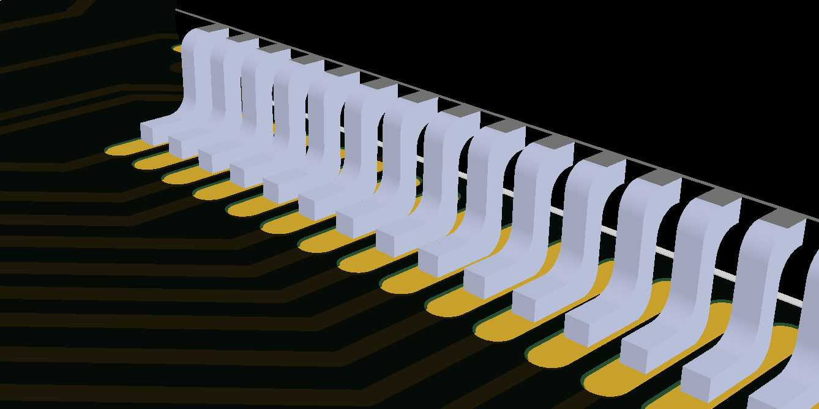
Component Pins on Pads / Lands
Figure 6. Component pins pads (gullwing leads) resting on surface mount pads on the top layer of a PCB
Notes:
So what’s next? There is a renaissance in hardware happening right now. Some people are calling it the hardware revolution. This revolution is really a convergence of several major trends happening in the space. And the end result is that it’s becoming easier and more economically viable for people to build things with hardware.
The hacker/maker movement has made hardware cool again. Hacklabs and makerspaces are springing up all over the world.
Arduino, raspberry pi, AVR, beaglebone have all emerged as easy entry point development platforms for people that aren’t EE’s but know how to code
3D printers and scanners have become a mass market product that allows people to imagine something and have a physical model within hours
Crowdfunding lets people guage market demand at the concept phase.
Specialized ems companies have sprung up all over the place that do quick turn prototyping. So now people can iterate on hardware products similarly to how they do with software
The barriers have come down for an individual or small company to get access to cheap, reliable volume production in China
IOT is driving a ton of new product ideas that are all hardware dependent. And analysts are predicting that it will be a massive market
Many of the major semi companies are jumping on the bandwagon. both Intel and TI announced major development efforts with Arduino. 2 years ago folks would have said that’s impossible.
More capital is coming into the space through incubators, accelerators and VCs will follow
From where I sit this all ads up to a big opportunity for supplyframe. There seem to be major parallels to how opens source drove a major wave in software.

Slide 34
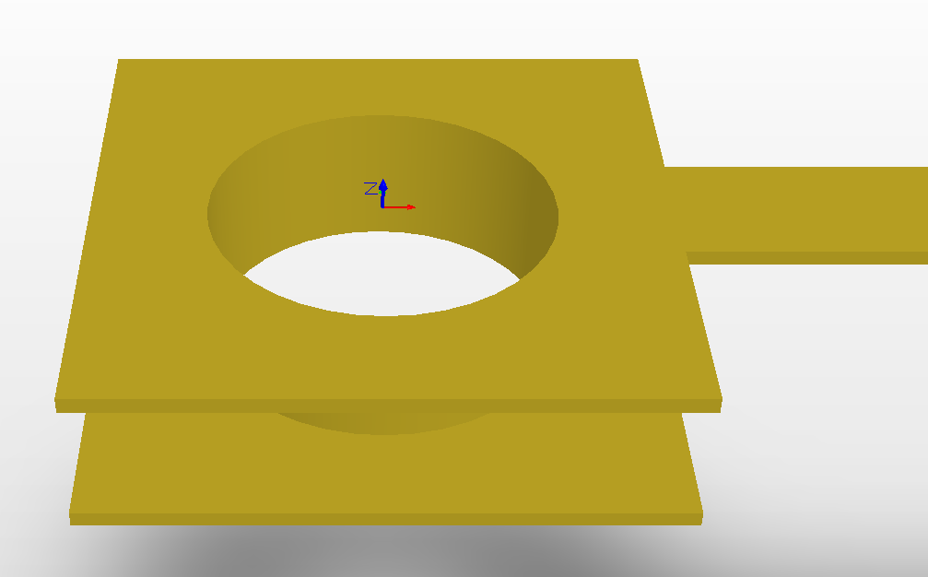
Plated Thru Hole Pad
Figure 7. Thru-hole pad with annular rings take solder on the top and bottom layers and a plated hole
Notes:
So what’s next? There is a renaissance in hardware happening right now. Some people are calling it the hardware revolution. This revolution is really a convergence of several major trends happening in the space. And the end result is that it’s becoming easier and more economically viable for people to build things with hardware.
The hacker/maker movement has made hardware cool again. Hacklabs and makerspaces are springing up all over the world.
Arduino, raspberry pi, AVR, beaglebone have all emerged as easy entry point development platforms for people that aren’t EE’s but know how to code
3D printers and scanners have become a mass market product that allows people to imagine something and have a physical model within hours
Crowdfunding lets people guage market demand at the concept phase.
Specialized ems companies have sprung up all over the place that do quick turn prototyping. So now people can iterate on hardware products similarly to how they do with software
The barriers have come down for an individual or small company to get access to cheap, reliable volume production in China
IOT is driving a ton of new product ideas that are all hardware dependent. And analysts are predicting that it will be a massive market
Many of the major semi companies are jumping on the bandwagon. both Intel and TI announced major development efforts with Arduino. 2 years ago folks would have said that’s impossible.
More capital is coming into the space through incubators, accelerators and VCs will follow
From where I sit this all ads up to a big opportunity for supplyframe. There seem to be major parallels to how opens source drove a major wave in software.

Slide 35
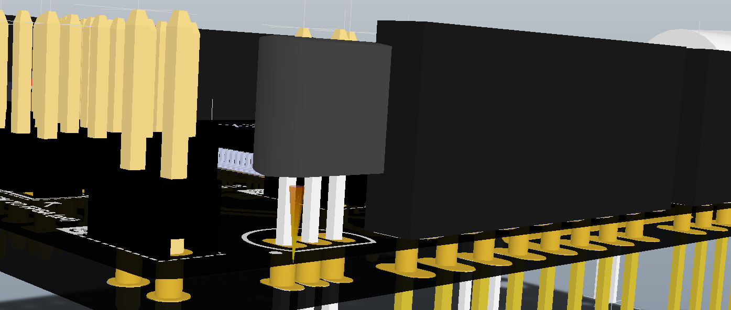
Cross Section of a PCB
Figure 7. Cross section of a printed circuit board
Notes:
So what’s next? There is a renaissance in hardware happening right now. Some people are calling it the hardware revolution. This revolution is really a convergence of several major trends happening in the space. And the end result is that it’s becoming easier and more economically viable for people to build things with hardware.
The hacker/maker movement has made hardware cool again. Hacklabs and makerspaces are springing up all over the world.
Arduino, raspberry pi, AVR, beaglebone have all emerged as easy entry point development platforms for people that aren’t EE’s but know how to code
3D printers and scanners have become a mass market product that allows people to imagine something and have a physical model within hours
Crowdfunding lets people guage market demand at the concept phase.
Specialized ems companies have sprung up all over the place that do quick turn prototyping. So now people can iterate on hardware products similarly to how they do with software
The barriers have come down for an individual or small company to get access to cheap, reliable volume production in China
IOT is driving a ton of new product ideas that are all hardware dependent. And analysts are predicting that it will be a massive market
Many of the major semi companies are jumping on the bandwagon. both Intel and TI announced major development efforts with Arduino. 2 years ago folks would have said that’s impossible.
More capital is coming into the space through incubators, accelerators and VCs will follow
From where I sit this all ads up to a big opportunity for supplyframe. There seem to be major parallels to how opens source drove a major wave in software.

Slide 36
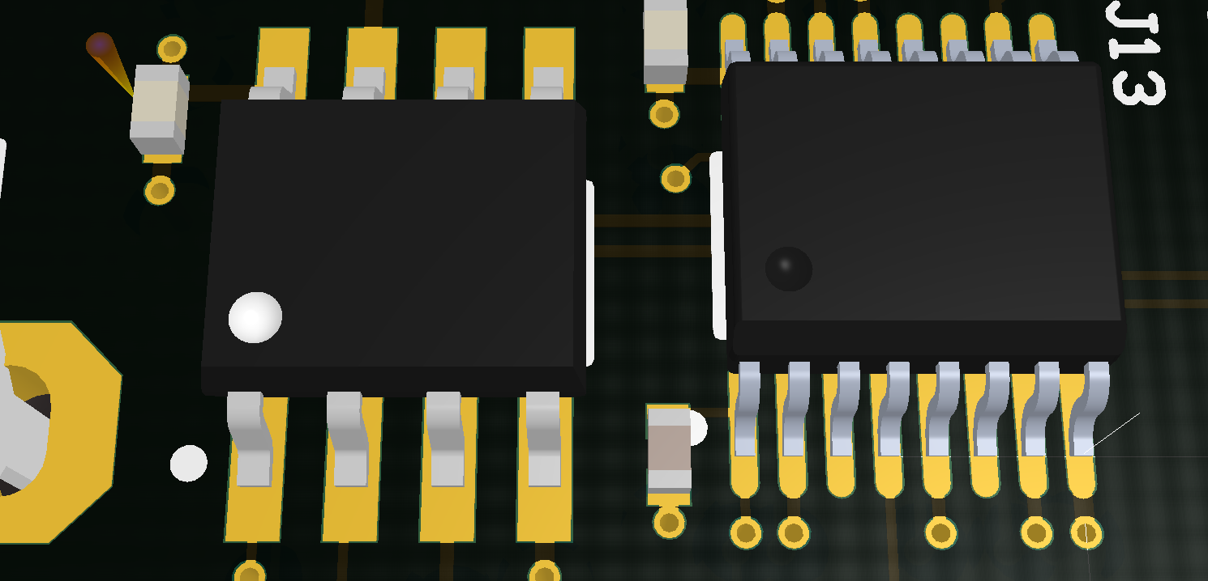
Pins on pads of a PCB footprint
Figure 8. Component pins make contact with slightly larger pads on the top layer of the PCB board
Notes:
So what’s next? There is a renaissance in hardware happening right now. Some people are calling it the hardware revolution. This revolution is really a convergence of several major trends happening in the space. And the end result is that it’s becoming easier and more economically viable for people to build things with hardware.
The hacker/maker movement has made hardware cool again. Hacklabs and makerspaces are springing up all over the world.
Arduino, raspberry pi, AVR, beaglebone have all emerged as easy entry point development platforms for people that aren’t EE’s but know how to code
3D printers and scanners have become a mass market product that allows people to imagine something and have a physical model within hours
Crowdfunding lets people guage market demand at the concept phase.
Specialized ems companies have sprung up all over the place that do quick turn prototyping. So now people can iterate on hardware products similarly to how they do with software
The barriers have come down for an individual or small company to get access to cheap, reliable volume production in China
IOT is driving a ton of new product ideas that are all hardware dependent. And analysts are predicting that it will be a massive market
Many of the major semi companies are jumping on the bandwagon. both Intel and TI announced major development efforts with Arduino. 2 years ago folks would have said that’s impossible.
More capital is coming into the space through incubators, accelerators and VCs will follow
From where I sit this all ads up to a big opportunity for supplyframe. There seem to be major parallels to how opens source drove a major wave in software.

Slide 37
Layers Signals, Routing, Stack-Ups

Slide 38
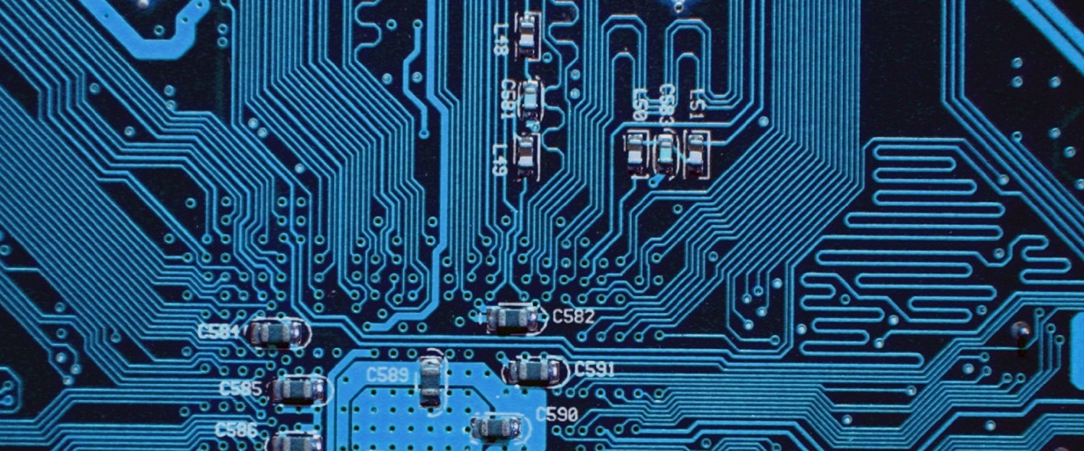
PCB Signal / Routing Layer
Figure 9. Signal layer with tracks and vias
Notes:
So what’s next? There is a renaissance in hardware happening right now. Some people are calling it the hardware revolution. This revolution is really a convergence of several major trends happening in the space. And the end result is that it’s becoming easier and more economically viable for people to build things with hardware.
The hacker/maker movement has made hardware cool again. Hacklabs and makerspaces are springing up all over the world.
Arduino, raspberry pi, AVR, beaglebone have all emerged as easy entry point development platforms for people that aren’t EE’s but know how to code
3D printers and scanners have become a mass market product that allows people to imagine something and have a physical model within hours
Crowdfunding lets people guage market demand at the concept phase.
Specialized ems companies have sprung up all over the place that do quick turn prototyping. So now people can iterate on hardware products similarly to how they do with software
The barriers have come down for an individual or small company to get access to cheap, reliable volume production in China
IOT is driving a ton of new product ideas that are all hardware dependent. And analysts are predicting that it will be a massive market
Many of the major semi companies are jumping on the bandwagon. both Intel and TI announced major development efforts with Arduino. 2 years ago folks would have said that’s impossible.
More capital is coming into the space through incubators, accelerators and VCs will follow
From where I sit this all ads up to a big opportunity for supplyframe. There seem to be major parallels to how opens source drove a major wave in software.

Slide 39
Cores, Common Stack-Ups, Multilayer PCBs

Slide 40
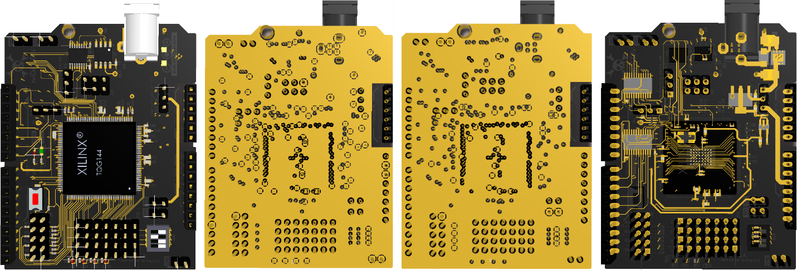
Layer by Layer 4-Layer PCB
Figure 10. Layer by layer view of a printed circuit board
Notes:
So what’s next? There is a renaissance in hardware happening right now. Some people are calling it the hardware revolution. This revolution is really a convergence of several major trends happening in the space. And the end result is that it’s becoming easier and more economically viable for people to build things with hardware.
The hacker/maker movement has made hardware cool again. Hacklabs and makerspaces are springing up all over the world.
Arduino, raspberry pi, AVR, beaglebone have all emerged as easy entry point development platforms for people that aren’t EE’s but know how to code
3D printers and scanners have become a mass market product that allows people to imagine something and have a physical model within hours
Crowdfunding lets people guage market demand at the concept phase.
Specialized ems companies have sprung up all over the place that do quick turn prototyping. So now people can iterate on hardware products similarly to how they do with software
The barriers have come down for an individual or small company to get access to cheap, reliable volume production in China
IOT is driving a ton of new product ideas that are all hardware dependent. And analysts are predicting that it will be a massive market
Many of the major semi companies are jumping on the bandwagon. both Intel and TI announced major development efforts with Arduino. 2 years ago folks would have said that’s impossible.
More capital is coming into the space through incubators, accelerators and VCs will follow
From where I sit this all ads up to a big opportunity for supplyframe. There seem to be major parallels to how opens source drove a major wave in software.

Slide 41
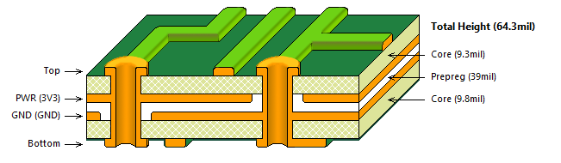
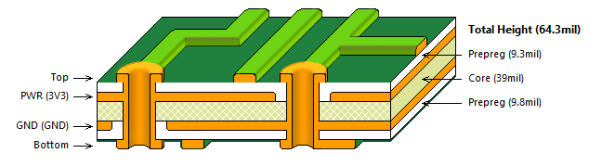
PCB Layer Stackup
Figure 11. Layer stackup of a typical 4 layer board
Notes:
So what’s next? There is a renaissance in hardware happening right now. Some people are calling it the hardware revolution. This revolution is really a convergence of several major trends happening in the space. And the end result is that it’s becoming easier and more economically viable for people to build things with hardware.
The hacker/maker movement has made hardware cool again. Hacklabs and makerspaces are springing up all over the world.
Arduino, raspberry pi, AVR, beaglebone have all emerged as easy entry point development platforms for people that aren’t EE’s but know how to code
3D printers and scanners have become a mass market product that allows people to imagine something and have a physical model within hours
Crowdfunding lets people guage market demand at the concept phase.
Specialized ems companies have sprung up all over the place that do quick turn prototyping. So now people can iterate on hardware products similarly to how they do with software
The barriers have come down for an individual or small company to get access to cheap, reliable volume production in China
IOT is driving a ton of new product ideas that are all hardware dependent. And analysts are predicting that it will be a massive market
Many of the major semi companies are jumping on the bandwagon. both Intel and TI announced major development efforts with Arduino. 2 years ago folks would have said that’s impossible.
More capital is coming into the space through incubators, accelerators and VCs will follow
From where I sit this all ads up to a big opportunity for supplyframe. There seem to be major parallels to how opens source drove a major wave in software.

Slide 42
Soldermask / Solder Resist

Slide 43
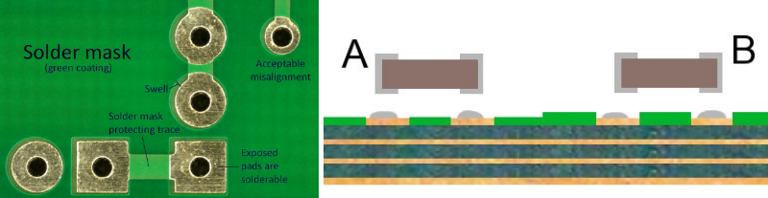
PCB Soldermask (colors may vary)
Figure 12. PCB Soldermask
Notes:
So what’s next? There is a renaissance in hardware happening right now. Some people are calling it the hardware revolution. This revolution is really a convergence of several major trends happening in the space. And the end result is that it’s becoming easier and more economically viable for people to build things with hardware.
The hacker/maker movement has made hardware cool again. Hacklabs and makerspaces are springing up all over the world.
Arduino, raspberry pi, AVR, beaglebone have all emerged as easy entry point development platforms for people that aren’t EE’s but know how to code
3D printers and scanners have become a mass market product that allows people to imagine something and have a physical model within hours
Crowdfunding lets people guage market demand at the concept phase.
Specialized ems companies have sprung up all over the place that do quick turn prototyping. So now people can iterate on hardware products similarly to how they do with software
The barriers have come down for an individual or small company to get access to cheap, reliable volume production in China
IOT is driving a ton of new product ideas that are all hardware dependent. And analysts are predicting that it will be a massive market
Many of the major semi companies are jumping on the bandwagon. both Intel and TI announced major development efforts with Arduino. 2 years ago folks would have said that’s impossible.
More capital is coming into the space through incubators, accelerators and VCs will follow
From where I sit this all ads up to a big opportunity for supplyframe. There seem to be major parallels to how opens source drove a major wave in software.

Slide 44
Solder Paste & Paste Mask

Slide 45



PCB Solder Paste Stencil
Figure 12. PCB File Paste Mask and Bottom Copper Layers
Figure 13. PCB Solder Paste Stencil
Notes:
So what’s next? There is a renaissance in hardware happening right now. Some people are calling it the hardware revolution. This revolution is really a convergence of several major trends happening in the space. And the end result is that it’s becoming easier and more economically viable for people to build things with hardware.
The hacker/maker movement has made hardware cool again. Hacklabs and makerspaces are springing up all over the world.
Arduino, raspberry pi, AVR, beaglebone have all emerged as easy entry point development platforms for people that aren’t EE’s but know how to code
3D printers and scanners have become a mass market product that allows people to imagine something and have a physical model within hours
Crowdfunding lets people guage market demand at the concept phase.
Specialized ems companies have sprung up all over the place that do quick turn prototyping. So now people can iterate on hardware products similarly to how they do with software
The barriers have come down for an individual or small company to get access to cheap, reliable volume production in China
IOT is driving a ton of new product ideas that are all hardware dependent. And analysts are predicting that it will be a massive market
Many of the major semi companies are jumping on the bandwagon. both Intel and TI announced major development efforts with Arduino. 2 years ago folks would have said that’s impossible.
More capital is coming into the space through incubators, accelerators and VCs will follow
From where I sit this all ads up to a big opportunity for supplyframe. There seem to be major parallels to how opens source drove a major wave in software.

Slide 46
Silkscreen (…And you thought they wouldn’t see)

Slide 47


PCB Silkscreen Designators, notations are good Part numbers, values, etc. are not
Notes:
So what’s next? There is a renaissance in hardware happening right now. Some people are calling it the hardware revolution. This revolution is really a convergence of several major trends happening in the space. And the end result is that it’s becoming easier and more economically viable for people to build things with hardware.
The hacker/maker movement has made hardware cool again. Hacklabs and makerspaces are springing up all over the world.
Arduino, raspberry pi, AVR, beaglebone have all emerged as easy entry point development platforms for people that aren’t EE’s but know how to code
3D printers and scanners have become a mass market product that allows people to imagine something and have a physical model within hours
Crowdfunding lets people guage market demand at the concept phase.
Specialized ems companies have sprung up all over the place that do quick turn prototyping. So now people can iterate on hardware products similarly to how they do with software
The barriers have come down for an individual or small company to get access to cheap, reliable volume production in China
IOT is driving a ton of new product ideas that are all hardware dependent. And analysts are predicting that it will be a massive market
Many of the major semi companies are jumping on the bandwagon. both Intel and TI announced major development efforts with Arduino. 2 years ago folks would have said that’s impossible.
More capital is coming into the space through incubators, accelerators and VCs will follow
From where I sit this all ads up to a big opportunity for supplyframe. There seem to be major parallels to how opens source drove a major wave in software.

Slide 48
Essentials of Manufacturing Fabrication & Assembly Basics
Notes:
So what’s next? There is a renaissance in hardware happening right now. Some people are calling it the hardware revolution. This revolution is really a convergence of several major trends happening in the space. And the end result is that it’s becoming easier and more economically viable for people to build things with hardware.
The hacker/maker movement has made hardware cool again. Hacklabs and makerspaces are springing up all over the world.
Arduino, raspberry pi, AVR, beaglebone have all emerged as easy entry point development platforms for people that aren’t EE’s but know how to code
3D printers and scanners have become a mass market product that allows people to imagine something and have a physical model within hours
Crowdfunding lets people guage market demand at the concept phase.
Specialized ems companies have sprung up all over the place that do quick turn prototyping. So now people can iterate on hardware products similarly to how they do with software
The barriers have come down for an individual or small company to get access to cheap, reliable volume production in China
IOT is driving a ton of new product ideas that are all hardware dependent. And analysts are predicting that it will be a massive market
Many of the major semi companies are jumping on the bandwagon. both Intel and TI announced major development efforts with Arduino. 2 years ago folks would have said that’s impossible.
More capital is coming into the space through incubators, accelerators and VCs will follow
From where I sit this all ads up to a big opportunity for supplyframe. There seem to be major parallels to how opens source drove a major wave in software.

Slide 49

Fabrication of the Bare Board
Notes:
So what’s next? There is a renaissance in hardware happening right now. Some people are calling it the hardware revolution. This revolution is really a convergence of several major trends happening in the space. And the end result is that it’s becoming easier and more economically viable for people to build things with hardware.
The hacker/maker movement has made hardware cool again. Hacklabs and makerspaces are springing up all over the world.
Arduino, raspberry pi, AVR, beaglebone have all emerged as easy entry point development platforms for people that aren’t EE’s but know how to code
3D printers and scanners have become a mass market product that allows people to imagine something and have a physical model within hours
Crowdfunding lets people guage market demand at the concept phase.
Specialized ems companies have sprung up all over the place that do quick turn prototyping. So now people can iterate on hardware products similarly to how they do with software
The barriers have come down for an individual or small company to get access to cheap, reliable volume production in China
IOT is driving a ton of new product ideas that are all hardware dependent. And analysts are predicting that it will be a massive market
Many of the major semi companies are jumping on the bandwagon. both Intel and TI announced major development efforts with Arduino. 2 years ago folks would have said that’s impossible.
More capital is coming into the space through incubators, accelerators and VCs will follow
From where I sit this all ads up to a big opportunity for supplyframe. There seem to be major parallels to how opens source drove a major wave in software.

Slide 50
Assembly, Pick and Place, Reflow

Slide 51

Production Soldering - Reflow
Figure 18. Reflow process flow or one and two-sided boards
Notes:
So what’s next? There is a renaissance in hardware happening right now. Some people are calling it the hardware revolution. This revolution is really a convergence of several major trends happening in the space. And the end result is that it’s becoming easier and more economically viable for people to build things with hardware.
The hacker/maker movement has made hardware cool again. Hacklabs and makerspaces are springing up all over the world.
Arduino, raspberry pi, AVR, beaglebone have all emerged as easy entry point development platforms for people that aren’t EE’s but know how to code
3D printers and scanners have become a mass market product that allows people to imagine something and have a physical model within hours
Crowdfunding lets people guage market demand at the concept phase.
Specialized ems companies have sprung up all over the place that do quick turn prototyping. So now people can iterate on hardware products similarly to how they do with software
The barriers have come down for an individual or small company to get access to cheap, reliable volume production in China
IOT is driving a ton of new product ideas that are all hardware dependent. And analysts are predicting that it will be a massive market
Many of the major semi companies are jumping on the bandwagon. both Intel and TI announced major development efforts with Arduino. 2 years ago folks would have said that’s impossible.
More capital is coming into the space through incubators, accelerators and VCs will follow
From where I sit this all ads up to a big opportunity for supplyframe. There seem to be major parallels to how opens source drove a major wave in software.

Slide 52
Wave Soldering

Slide 53

Production Soldering - Wave
Figure 19. Wave soldering process passes board over a wave of molten solder
Notes:
So what’s next? There is a renaissance in hardware happening right now. Some people are calling it the hardware revolution. This revolution is really a convergence of several major trends happening in the space. And the end result is that it’s becoming easier and more economically viable for people to build things with hardware.
The hacker/maker movement has made hardware cool again. Hacklabs and makerspaces are springing up all over the world.
Arduino, raspberry pi, AVR, beaglebone have all emerged as easy entry point development platforms for people that aren’t EE’s but know how to code
3D printers and scanners have become a mass market product that allows people to imagine something and have a physical model within hours
Crowdfunding lets people guage market demand at the concept phase.
Specialized ems companies have sprung up all over the place that do quick turn prototyping. So now people can iterate on hardware products similarly to how they do with software
The barriers have come down for an individual or small company to get access to cheap, reliable volume production in China
IOT is driving a ton of new product ideas that are all hardware dependent. And analysts are predicting that it will be a massive market
Many of the major semi companies are jumping on the bandwagon. both Intel and TI announced major development efforts with Arduino. 2 years ago folks would have said that’s impossible.
More capital is coming into the space through incubators, accelerators and VCs will follow
From where I sit this all ads up to a big opportunity for supplyframe. There seem to be major parallels to how opens source drove a major wave in software.

Slide 54
Got it? Good. Because now it gets real

Slide 55
Rule No. 1
The board is part of the circuit
Just like any other component
Harder to quantify its behavior / Effects
You *can* control for the board, with care and some basic know-how

Slide 56


Slide 57

Level-Set: The world is not ideal
Copper is NOT a super conductor, nor is solder
PCB traces have resistance, impedance, inductance
Pins and pads have capacitance, impedance
Vias are inductive, capacitive
Coupling occurs between tracks, polygons, planes, etc.
Noise propagates along signal paths, ground planes
Amplifiers amplify
Digital signals are noisy
Antennas hear it all
Remember your R’L’G’C’s
Gaaaaaahhhhh!
…YET we manage to build stuff that works every day, so chill

Slide 58
The gritty bits subheading: don’t do anything, just look at what it’s telling you

Slide 59

Sheet Resistance Calculation
*It doesn’t take complex math…just look at it
As the conductor length (Z) increases, resistance increases
As the conductor width (X) increases, resistance decreases
As the Cu thickness (Y) increases, resistance decreases

Slide 60

Parallel Plate Capacitor
*It doesn’t take complex math…just look at it
As the copper area increases, so does the capacitance
As the relative dielectric increases, so does the capacitance
As the distance between features increases, the capacitance decreases

Slide 61

Trace Inductance Formula
*It doesn’t take complex math…just look at it
As the length increases, so does the inductance
As the width increases, the inductance decreases
As the height increases, the inductance decreases

Slide 62

Via Inductance Formula
*It doesn’t take complex math…just look at it
As the Z-axis length of a via increases, so does the inductance
As the diameter decreases, the inductance increases

Slide 63

Via Capacitance Formula
*It doesn’t take complex math…just look at it
The wider the annular ring, the lower the capacitance
The greater the distance between the pad and the plane, the lower the capacitance
As the via height (t) (board thickness) increases, so does the capacitance

Slide 64

Trace Impedance Formula
*It doesn’t take complex math…just look at it
The wider the trace (W), the lower the impedance
The thicker the copper (T), the lower the impedance
The greater the distance between the track and the plane (H), the greater the impedance*
* good to compare 2 vs 4 layer trace impedance!

Slide 65



Standard Board Construction
Ex. Sunstone Circuits

Slide 66
Developing some rules of thumb subheading: don’t freak out

Slide 67
Power distribution & GROUNDING

Slide 68

Power Distribution Networks
Power lines should be kept to the lowest possible impedance √(L/C)
Greater width = lower impedance, thicker copper = lower impedance
Long power lines couple in more noise from other parts of the circuit and parade that noise everywhere they go…keep @%^& short and isolate!
Single GND, Shared Return Path
Multiple returns, shared return path
Multiple returns, isolated return paths

Slide 69
Power Distribution Networks
Ground planes should be unbroken where possible
Ground planes should not be mixed with power or other signals where possible
Route digital signals *around* analog ground planes
Isolate returns whenever possible (nobody likes the noisemakers at the party)
Single GND, Shared Return Path
Multiple returns, shared return path
Multiple returns, isolated return paths

Slide 70
Track Width & routing

Slide 71

How do I pick a track width?
Power Supply -> Far more scientific…based on ampacity (current)
Current carrying capacity
Temperature Rise
Thickness of copper
Width of the track
Current requirements
IPC 2221 Formula:
i=K×∆T^{0.44}×Ac^{0.725}
Where:
i = required current
K = 0.048 for external layers
0.024 for internal layers
∆T = temp rise in ºC
Ac = cross sectional area (width x thickness)

Slide 72
How do I ROUTE IT?
12 mil
15 mil
Power Supply -> Some rules of thumb
Base your routing width on 1.5-2x the required current
Use planes whenever possible
Avoid long return paths, shorter is better, best = via to solid plane
Avoid long unterminated stubs (antennae)*
Give yourself meaningful clearance between traces
“Neck Down” tracks to enter pads at pad width or slightly smaller
Avoid splitting power and ground on the same layer
Avoid digital signals over analog ground planes (more on this)
* Straight conductors (unterminated) have parasitic inductance and concentrate flux lines (magnetics) from the world around them…this is the principle of a whip antenna and straight, unterminated tracks can operate like antennas on the board concentrating noise and introducing it to a circuit
20 mil
25 mil
30 mil

Slide 73

Power Supply Clearances
Power Supply -> Some rules of thumb
IPC-9592 specifies that for voltages .>= 100V, the formula for minimum clearance vs. voltage to be (linear):
SPACING (mm) = 0.6 + Vpeak x .005
For voltages < 100V the formula is:
0.13mm for V<15V
0.25mm for 15V≤V<30V
0.1+Vpeak×0.01 for 30V≤V<100V
Larger clearances are better and a nice rule of thumb is to allow clearance to match track width for most low-voltage circuits (for power):
20mil track x 20mil spacing
RULE: Don’t follow this chart…this is a minimum…maintain a minimum of 10 mils clearance for low power nets and life will be good (most of the time:)

Slide 74


Digital Signals
Regarded as the noisy bunch, though reasonably noise-immune themselves
Should be kept as short as possible to avoid parading noise around the board
Should be kept away from sensitive analog signals where possible and avoid crossing analog GND planes
Run orthogonal on adjacent layers to limit crosstalk and noise issues
Isolate digital ground from analog ground wherever possible*
*does not apply to ADCs and DACs…a DACs DGND and AGND pins should both be tied to AGND plane as close to the component as possible →→→→→

Slide 75
How do I pick a track width?
15 mil
12 mil
Digital Signals-> <= Scientific (High speed excepted)
Some rules of thumb
As trace width decreases, resistance increases
As length increases, so does resistance
As trace width increases, capacitance (particularly with the presence of a GND plane) increases
Under most non-RF or non-”High Speed” circumstances, it is aesthetics and cost (PCB fab) that drive this
- W < 5mil = ↑$...
Typical track widths: 5, 7, 8, 10, 12, 15, 20, 25, 50…
You can use larger tracks to make life simpler
10 mil
7 mil
5 mil

Slide 76
How do I pick a track width?
15 mil
12 mil
Digital Signals-> Some rules of thumb
Wider traces are easier to etch chemically and route with a CNC machine
Building in-house prototypes, look for 15 mil tracks and 15 mil spacing min. unless using a precision mill
Chemical etch can be hard to time right, unpredictable, good to “go big”
PCB manufacturer’s can reliably handle 5mil tracks and 5mil spacing (so-called 5x5)
Larger tracks / spacing = better yield = lower cost
Don’t overdo it…no one likes and overachiever when it comes to track width (don’t waste space)
Super-wide tracks introduce additional capacitance, can be problematic in higher speed circuits
10 mil
7 mil
5 mil

Slide 77

Via / Hole size
Ex. Sunstone Circuits
Selecting a via size for “typical” circuits
Most low-cost fabs will require >= 15 mil via holes
Full service board houses will provide sizes much smaller but typically charge more for <= 12 mil diameter
Aim for 1.8x-2.0x hole diameter for annular ring size
Manufacturer’s will “round” to their nearest size and all mfg will have a standard size they recommend / prefer

Slide 78
Parts placement

Slide 79

Parts Placement
The world loves little cities…hates urban sprawl (don’t be LA, be Shanghai)
Group analog and digital circuits into separate sections
Keep sections (power, MCU, transceiver, analog, etc) tight though maintain enough room for soldering, esp. if soldering by hand
Watch the tall parts vs. short parts and don’t paint yourself into a corner when hand-soldering (can’t reach something)
Components slip when soldering (float), keep parts >10 mils apart for machine assembly and >20 for hand assembly unless you have serious soldering chops
Keep decoupling to w/in a min of 100 mil of the component pins, 50 mil is better
Keep analog circuits close to the board’s IO
Keep components 150mils from the edge of the board so clamps can be used

Slide 80

TIPS
Follow the IPC Specifications (IPC-7351)
Designed to remove ambiguity with SMT parts handling and PCB land-pattern geometries
Comes with IPC Footprint Calculator
Refer to IPC-7351 tables 3.1 – 3.22
Join forums like www.pcblibraries.com or the IPC designer’s council forum
Manufacturers will be able to tell you minimum / recommended annular ring on thru-hole pads
Get samples, print the design 1:1 and have a look…May not tell you it’s mfg-worthy but will tell you if the overall size is completely wrong
Pay careful attention to pad numbering
Never obscure pads with silkscreen or anything else
Ask, ask, ask…Average the answers :)
…And (note to self) always tent the vias under your BGAs

Slide 81
Links or stuff to get, read, learn
IPC2221 (Free online…you’ll find a PDF, just have a copy)
IPC2152 – like 2221 but more accurate and more use of tables
IPC7351 – buy this little jewel…it may be pricey but it’s worth it
Join forums:
Electronics Exchange
All About Circuits
PCBLibraries.com
IPC Designer’s Council
Search – PCB Pad Size, PCB Footprint Size, PCB Land Pattern
Saturn PCB calculator – you want this
AppCAD PCB – you want this
PCB Library Expert Lite – Free, you want this…always nice to buy it if you can
Read the books from the American Radio and Relay League
US Navy electronics resource are decent

Slide 82
Links or stuff to get, read, learn
Good soldering kit – Aoyue, Weller (though specialized tips on some)
Multimeter
USB to serial port adapter (you will need this with great frequency)
Oscilloscope – you need to get eyes into your circuit
Logic analyzer (USB are ok…look at Saeleg, not bad, min 8-channel)
Tweezers (Vetus brand are nice, you want decent sets of different tips)
Solder + flux (flux should be both a jar of paste and a pen)
PCB circuit cleaner (spray from RadioShack)
A few extra tooth brushes for cleaning boards, soft tip, none of that wonky gum massage nonsense
XACTO knife with replacement blades
Wire strippers
Solid core wire (22 gauge)
Stranded wire (important to take stress off of solder joints)
Hot air setup / hotplate

Slide 83
Image Attribution
https://www.google.com/url?sa=i&rct=j&q=&esrc=s&source=images&cd=&cad=rja&uact=8&ved=0CAUQjhw&url=https%3A%2F%2Fblog.adafruit.com%2F2012%2F02%2F17%2Fpcb-layout-and-etching-tips-and-tricks%2F&ei=4dtSVbvWN4XEsAWEmICIDw&bvm=bv.93112503,d.b2w&psig=AFQjCNEvFvBzMOuxcO2c_6rBytea3TESvQ&ust=1431579999907564
http://www.robotroom.com/Silkscreen-and-Solder-Mask-1.html
http://blog.screamingcircuits.com/2007/11/soldermask-and.html
http://hubhomedesign.com/smt-stencils-laser-cut-stencils-solder-paste-circuit
http://dangerousprototypes.com/2012/01/12/itead-mystery-pcb-high-power-rgb-led-driver/
http://www.pcb.co.uk/PCBPrototyping
http://www.douglaskrantz.com/Mixed_Assembly.html
http://www.analog.com/library/analogDialogue/archives/39-09/layout.html

Slide 84
Big THANKS
It’s hard these days to create anything original because as it were, the physics simply doesn’t change. So to state anything is to restate almost everything, just with perhaps a different audience focus and a different conversational tone. I wanted to cite a number of pro’s I have borrowed ideas, thoughts, experiments, etc. from for this presentation.
Firstly, having done this for a time I have been lucky to find time to read the Signal Integrity notables and I borrow information and insights from them all the time, specifically:
Doug Brooks, Eric Bogatin, & Howard Johnson
Buy their books, read their articles, and expand your mind. I promise you will not be disappointed. You might be lost, but you will not be disappointed.
Also the analog heavyweights:
Jim Williams, Robert Dobkins, Bob Widlar, Bob Pease, Paul Rako, & Paul Grohe, also the whole team from early TI, National, Linear, Analog Devices, etc. whose papers I covet with great affection and have read time and time again.
I have learned more watching / reading content by these folks than I care to admit but rest assured, I hold them all in high regard. None of this content would be possible without their contribution.
And lastly, in preparing this presentation, I relied heavily on content summarized brilliantly by the great John Ardizzoni from Analog Devices and a number of his (many) publications he has released to make PCB and analog understandable. I would encourage anyone to read John’s content and follow him with great enthusiasm. He knows his stuff. I can only channel half of the stuff he has in his head on a good day and he’s a brilliant writer as well.

